Slide 1
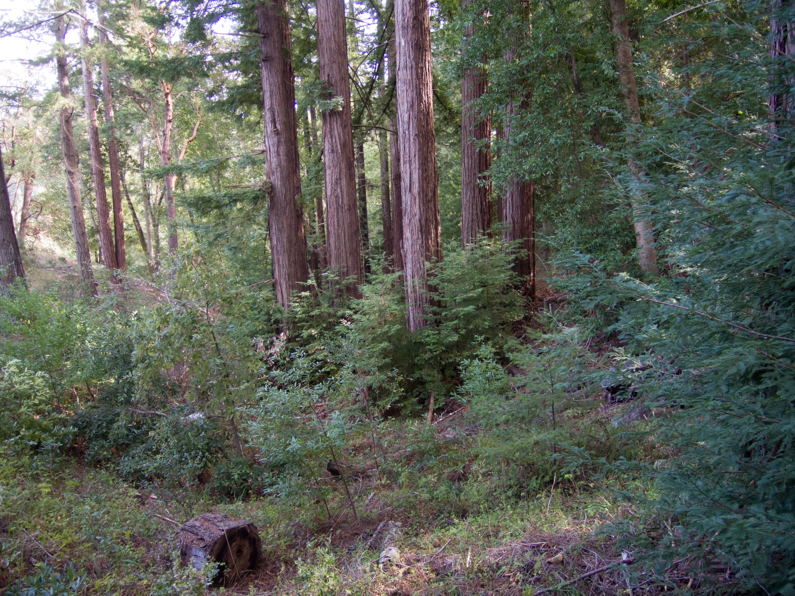

February 2022
Notes:
So, what does this teach us?
Cutting trees in stream beds can reverse channel incision. If we pile the branches from the tops on the stumps and burn them, that might inhibit or spread out the crown sprouts, doing more to inhibit or even reverse channel incision. We would still get the fast growth but with less internal stress that produces bowing, cracking, and twisting in very expensive lumber.
On the other hand, although it may be cheap and easy to log and expect crown sprouts to provide faster growth, maybe we would get better wood with finer grain and less internal stress to start from seed trees instead of relying upon crown sprouting. We would also retain more rational stand spacing with less labor to perform repeated “pre-commercial thinning.” The problem is how to kill stumps and that isn’t easy or cheap and has its hazards to remaining trees we will discuss.

Slide 2
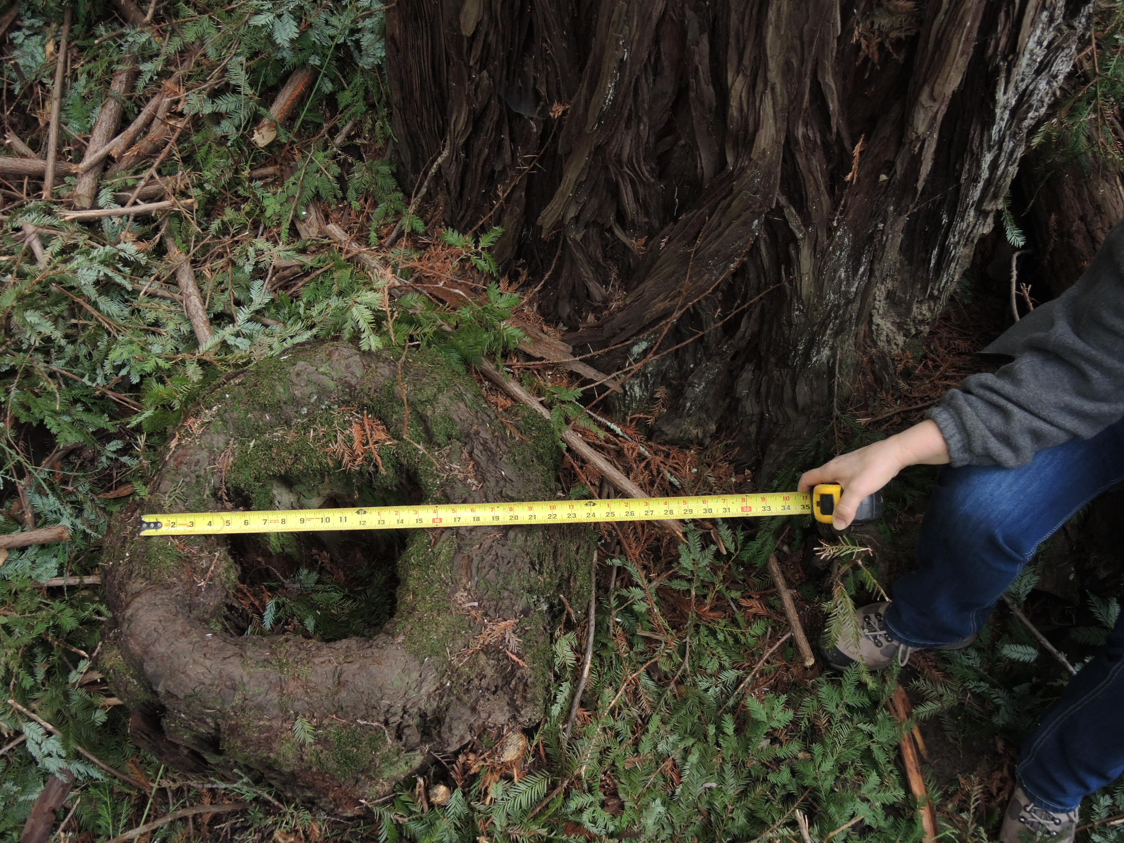
December 2015
Notes:
So as to our last question about Stand #1, what about those hollow stems? This was the biggest of the suckers I’d cut down in the 1990s at 22” So, why is it already hollow? The stumps of the solid trees I cut are not, but they do have holes of varying size depending upon location.
Well, here I’m going leave you hanging.
Because in order to explain that, I will first have to introduce you to the Spanish Gulch!

Slide 3
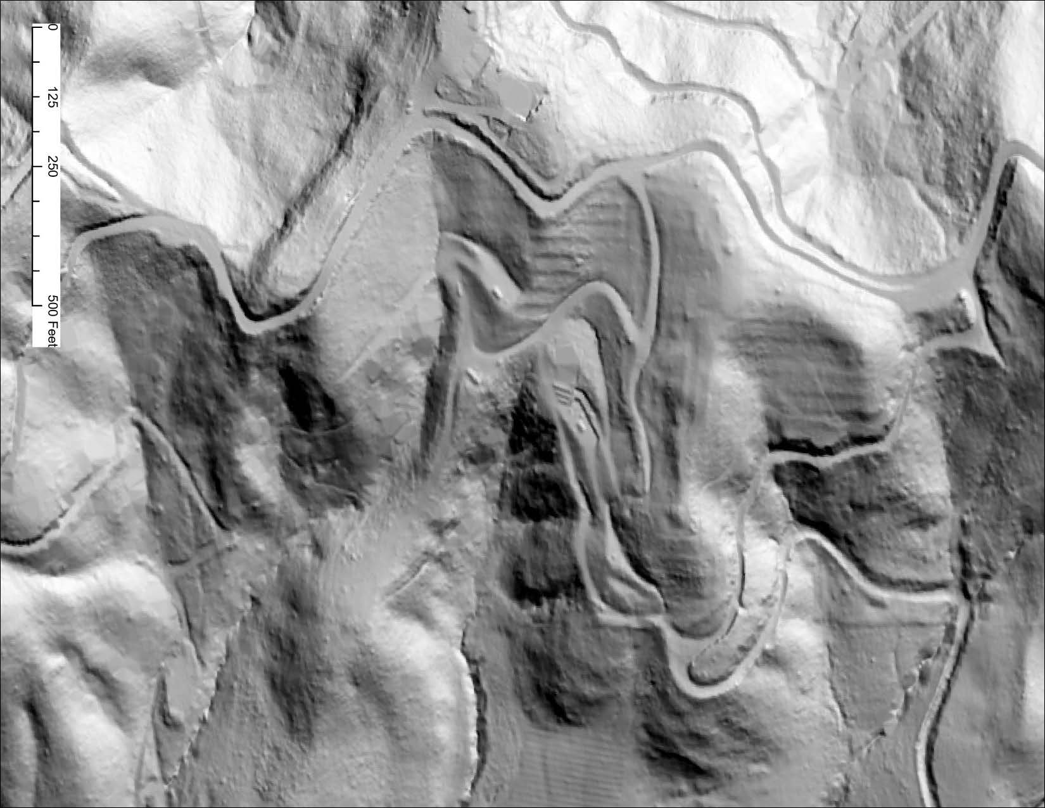
N
The Spanish Gulch
And Stand #2
The Spanish Gulch
And Stand #2
The Spanish Gulch
And Stand #2
Notes:
We’re back to that LIDAR image of the whole property. It is obvious that people have exerted major influences here for a long time: roads, trails, terraces from Ed Fenn’s apple orchard, our driveway, the veggie garden, our weed composting heap, the biochar pile... Yet the biggie here in terms of human influence on this image is probably invisible to you, partly because it’s so big.

Slide 4
N
Notes:
These mountains are composed of “marine uplift,” largely sedimentary rock pushed up by tectonic forces between the Pacific Plate and the North American continent. This part of Mountain Charlie Ridge is big jumbled sheets of highly erosive “Vaquero Sandstone.” The edges of the harder sheets erode more slowly, forming ridges (white lines) separating deeply-incised drainages. Note this ridge on the upper left, again marked in white. That dark shadow just above it is a nearly vertical cliff, in places about 40ft high. That sandstone wall is very hard sandstone.
Toward the bottom left, that ridge just simply ends as a, sharp and steep promentory, what I call a “rock nose.”

Slide 5
N
Notes:
These mountains have always been highly erosive. Here I’m showing the pattern of the original pre-colonial channels.
Some ended in incising streams while others in alluvial fans depending upon collection area.
Almost all of these ridges have a similar terminus: a soft cone of sediment around the end with but one exception here on the upper left.
This rock nose once had a similarly smooth conical slope of softer eroded fines just like the other ones.

Slide 6
N
Road
Crest
Culvert
Notes:
Yet today, there is this deep channel cut into the hill, but with no water running in it. The top and sidewall edges are sharp and not weathered off, this despite that it is relatively soft material, thus indicating that whatever made this gully was geologically recent.
Because of the alluvial nature of the material around the nose, the cause of this gully had to be water erosion, a lot of it. The problem is that there is no sign of water in the bottom now. In fact, the water from the road flows away from the top of the gully and eventually goes around it.

Slide 7
N
Original Headwall
Spanish
El Camino
1
1
1
1
Notes:
Here is what I think happened: The Spanish needed a trail between missions Santa Clara and Santa Cruz. The route followed a trail long used by the Sayante tribe (in yellow). The Spanish had to get ox carts past that cliff. But given that the Spanish engineer had only 500 Indians digging with sticks and baskets in August, they had to dig in the softer material. To ease the climb for animals coming up to the Summit from Santa Cruz the road was graded gradually downward to the south around the rock nose and sloped inward to keep two-wheeled ox carts from sliding off a muddy track in winter.
The rainwater on the ridge was collected by the road and went over the edge at the corner, hopefully to disperse over what was originally a convex rounded surface. But all there was to inhibit the erosion was at most grass. So instead of a convex surface dispersing the flow, the runoff from the road quickly cut a ditch into that loose alluvium, and it cut, and it cut, and it kept cutting. The sidewalls caved in repeatedly, making it wider as it went deeper and deeper, and deeper.

Slide 8
N
Original Headwall
Sidewalls
Notes:
I call it the Spanish Gulch.
Every time the sidewalls slid into the channel, it left bare mineral soil. And as we know, redwood seedlings need bare mineral soil to survive the summer competing against other plants.

Slide 9
N
Original Headwall
Sidewalls
2
2
2
Notes:
A stand of seed trees established on the north facing side of the gulch (in red) as the beginnings of Stand #2.

Slide 10
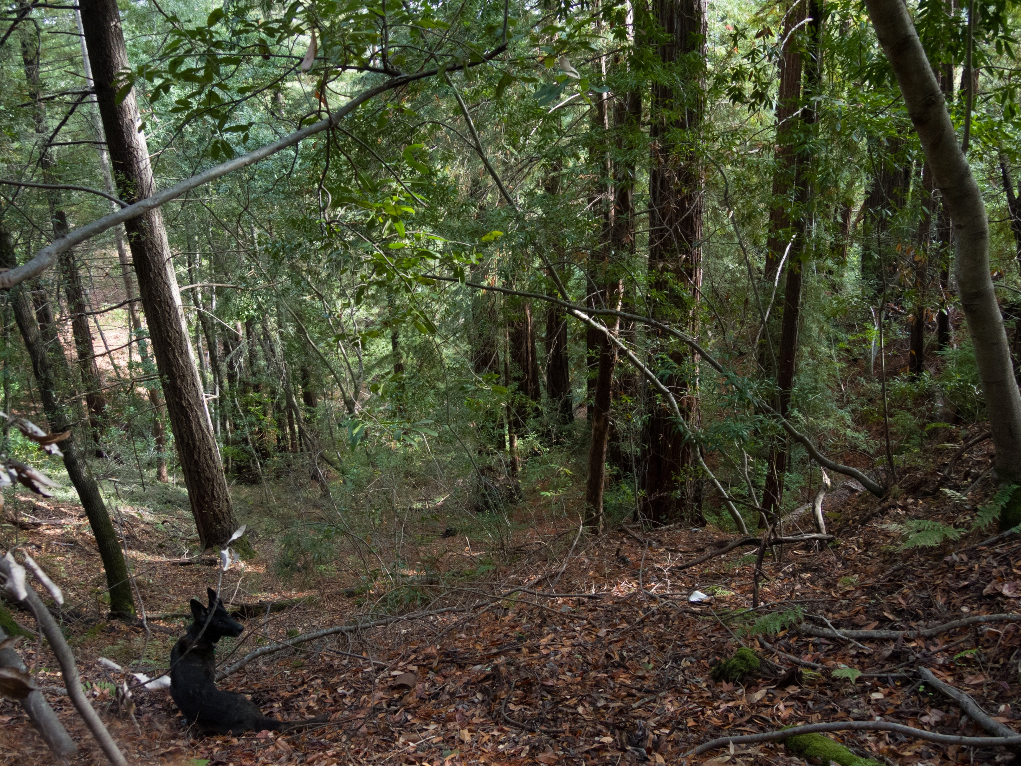
N
Likely Original Grade
2
Fir
Trees
1
1
1
December 2015
Notes:
And here they are on the right, Redwood Stand #2 on the north facing side, looking down the Spanish Gulch.
It is very hard to visualize the loss of the estimated 30-40,000 cubic yards that made this. The channel bottom cross section is in red. This orange line represents the original grade of the cone around the rock nose above and behind the photo point. I had UCSC project geologist, Dr. Gerry Webber come look at this and he considered the hypothesis reasonable.
And in this stand on the right, on the north-facing side, we see don’t see any fairy rings in here. There are no sprouts from old stumps. These are again seed trees that have never been logged.

Slide 11
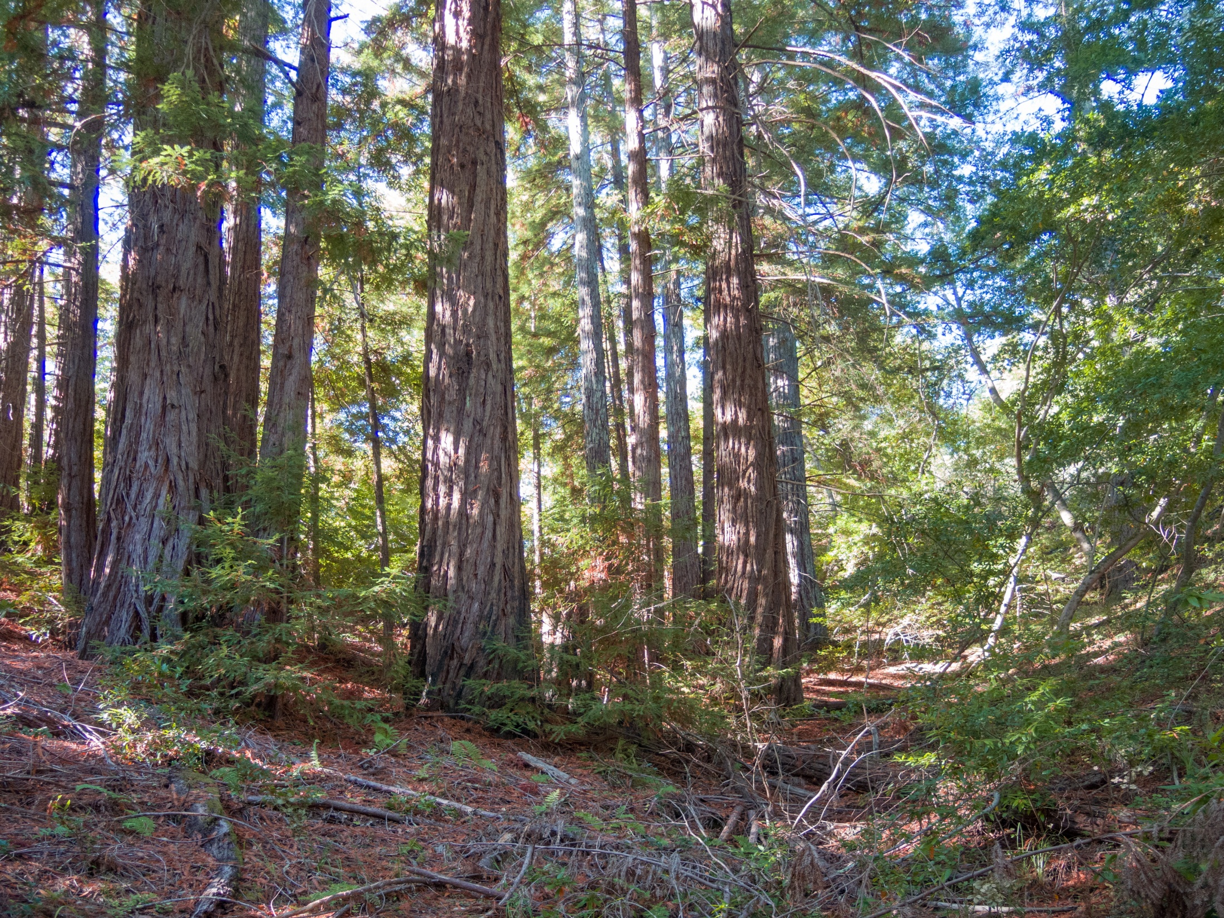
March 2022
Notes:
Looking up the Gulch from from below, this is the same upper group in stand #2.
We see don’t see any fairy rings. There are few suckers, but not from old stumps.
From what I can tell, these seed trees are too small and of uniform age to be pre-colonial growth and would not be here at all without the erosion caused by the Spanish trail built in 1791. But they are also so bigger than our other seed trees in stand #1 logged between 1880-90. The spiral bark also indicates that they are older too. So I’m guessing these germinated some time between 1800 and 1850 during the Spanish colonial period and were therefore not big enough to be worth logging so far above Glenwood and below Mountain Charlie Road in 1880. They are NOT old growth, by my definition of the term. They are of European origin.
I will be cleaning up this stand and thinning it a little, but have no idea what I will do with the logs as this location is far from a road and most of the trees I will take down will be smaller.

Slide 12
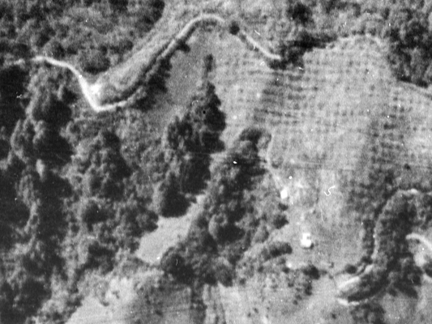
N
2
2
2
1
1
1
Image from Flight C-1436 Frame 11, 1931
Courtesy of UCSB Library Geospatial Collection
Image from Flight C-1436 Frame 11, 1931
Courtesy of UCSB Library Geospatial Collection
Image from Flight C-1436 Frame 11, 1931
Courtesy of UCSB Library Geospatial Collection
Notes:
So, where did the seed for Stand #2 originate? I don’t think it was Old Growth tree #1
Do you see another fairy ring here?

Slide 13
N
1
2
1
2
2
2
1
1
1
Image from Flight C-1436 Frame 11, 1931
Courtesy of UCSB Library Geospatial Collection
Image from Flight C-1436 Frame 11, 1931
Courtesy of UCSB Library Geospatial Collection
Image from Flight C-1436 Frame 11, 1931
Courtesy of UCSB Library Geospatial Collection
Notes:
Right here.
This was a pre-colonial tree but it was not on our property

Slide 14
N
Typical
Storm
Winds
150 feet
DOWNHILL
220 feet UPHILL
2
2
2
1
1
Image from Flight C-1436 Frame 11, 1931
Courtesy of UCSB Library Geospatial Collection
Image from Flight C-1436 Frame 11, 1931
Courtesy of UCSB Library Geospatial Collection
Image from Flight C-1436 Frame 11, 1931
Courtesy of UCSB Library Geospatial Collection
Notes:
It is more likely that the seed from this tree started that upper group was blown in from; 150 feet to the south.
That is also the direction of typical southerly winds of early winter storms when redwoods drop their seed.

Slide 15
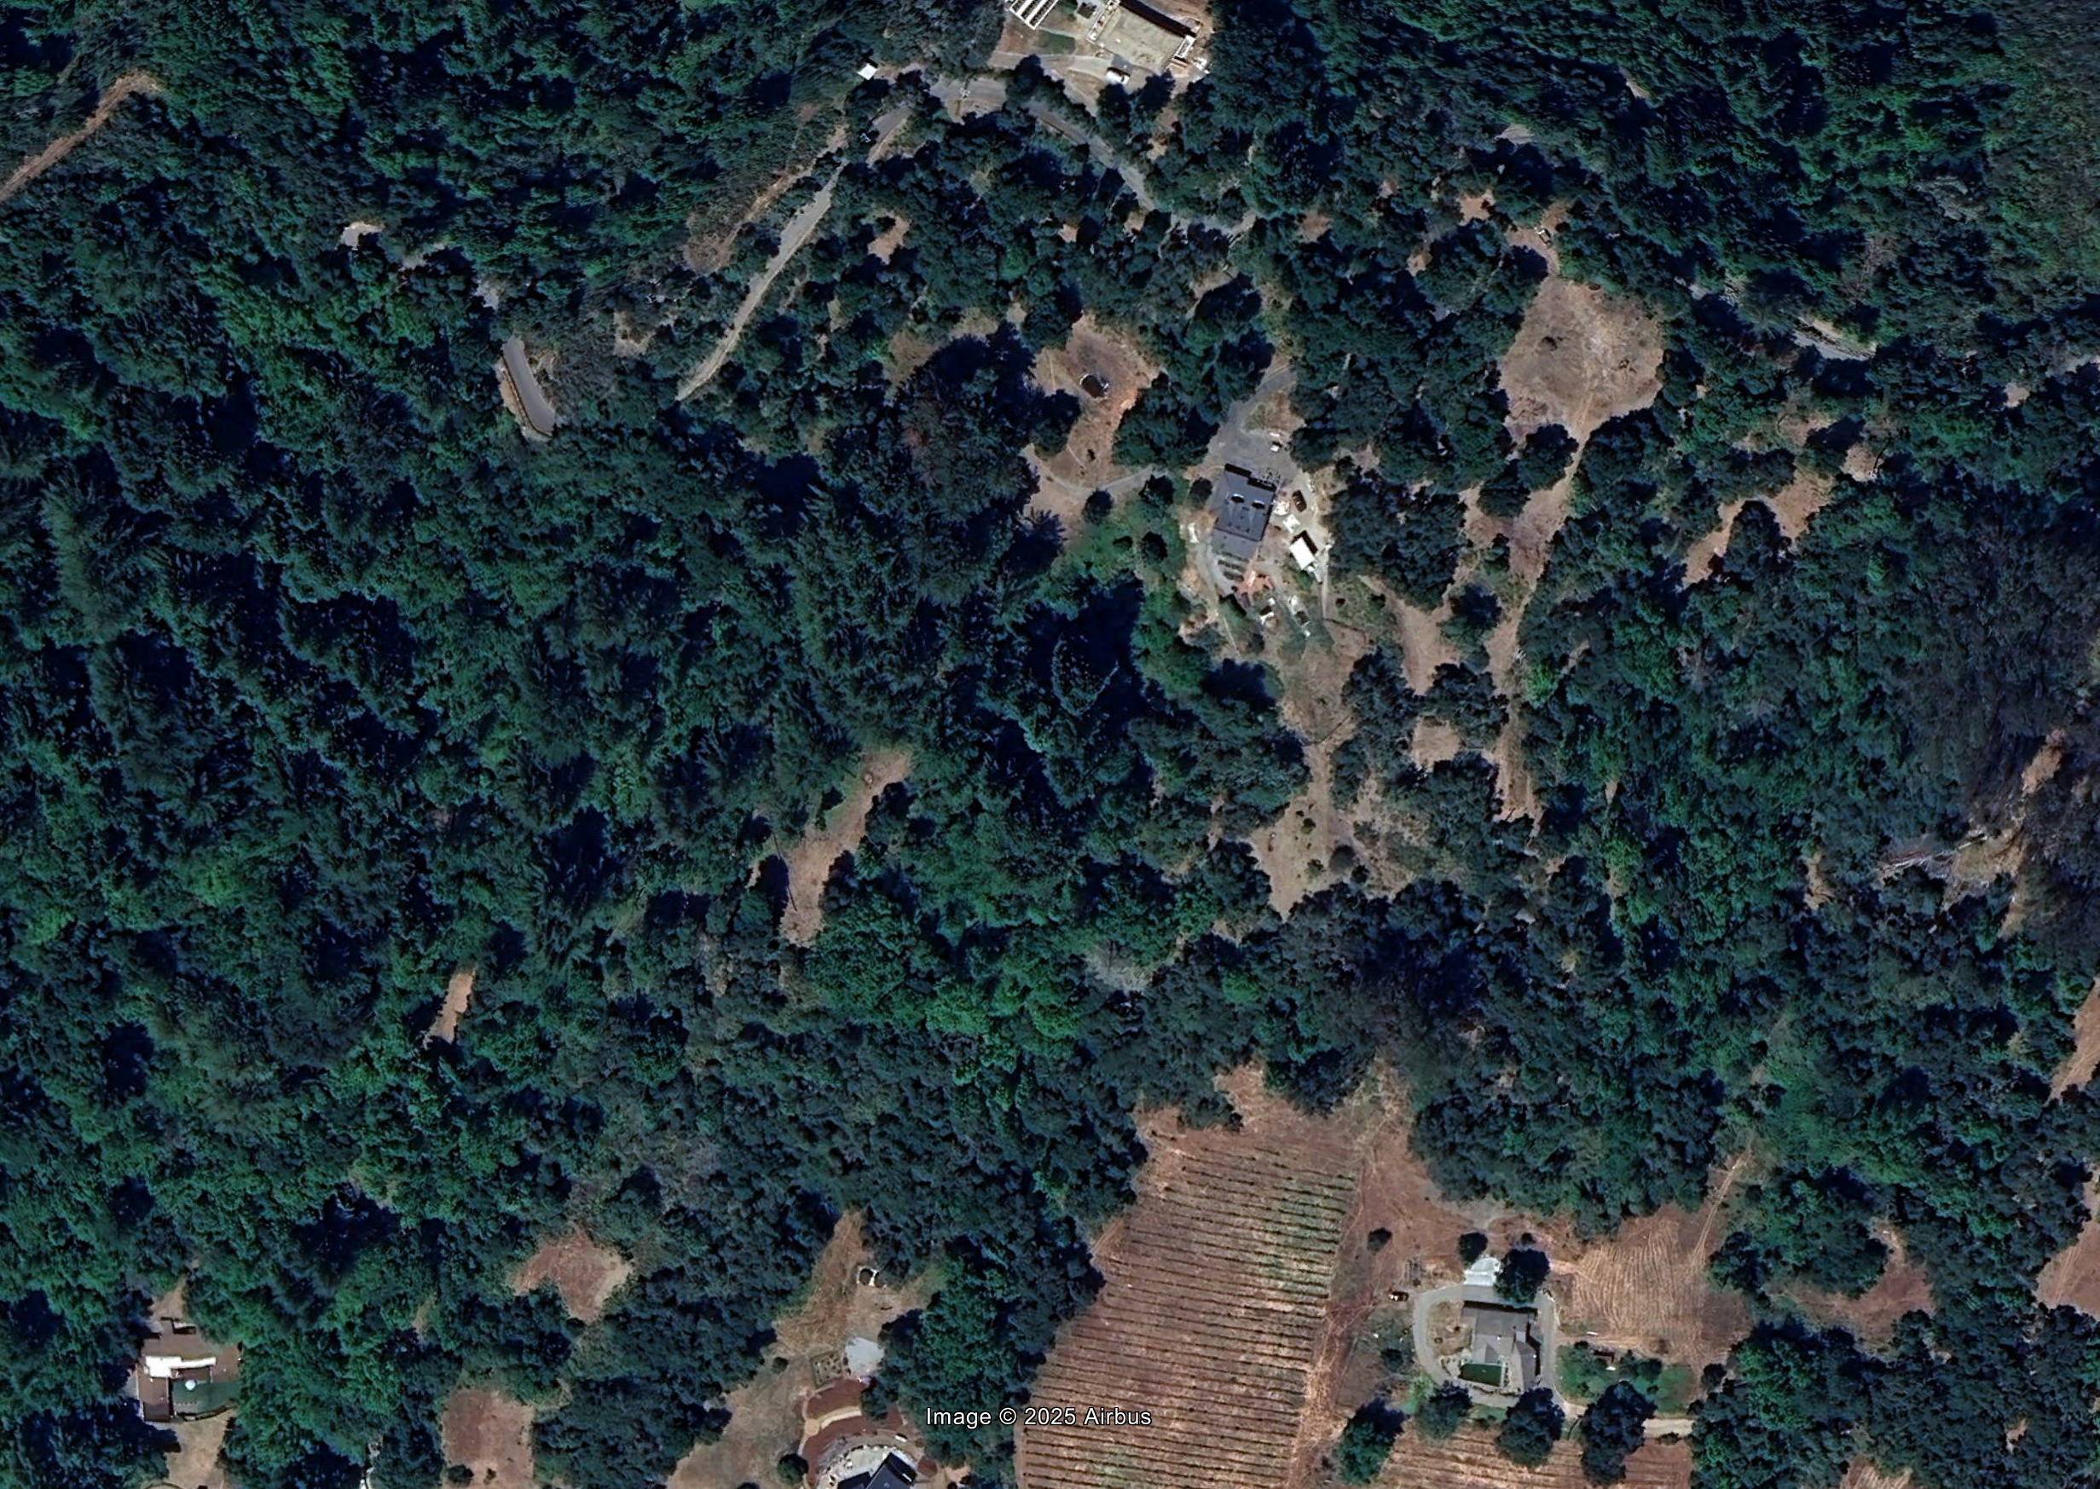
N
2
2
2
2A
2B
2C
Notes:
Now as for the monoculture redwood patches at the bottom of stand #2, those are also seed trees genetically from Old Growth Tree #2 but they are considerably younger than those above.
These started in stages after Tree #1 was logged labeled in order they germinated

Slide 16
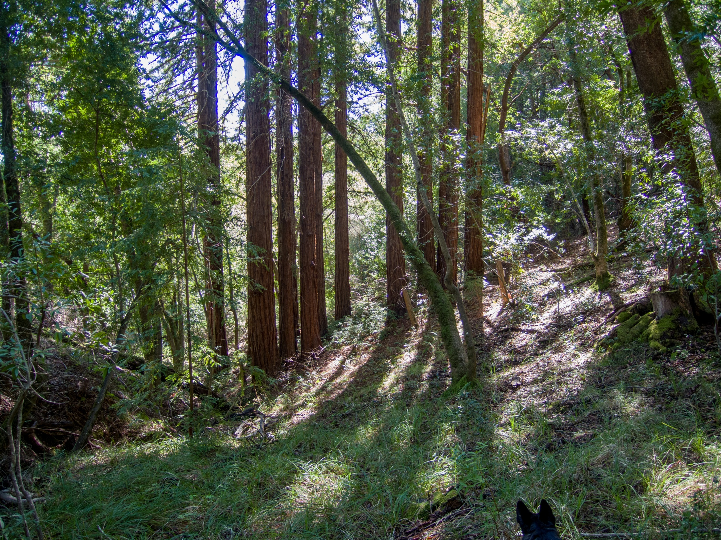
2C
February 2022
Notes:
And here they are on top of what appears to be a landslide deposit from the Spanish Gulch.
But with most of the water in this drainage following this path in blue, why didn’t the toe of the slide wash away?

Slide 17
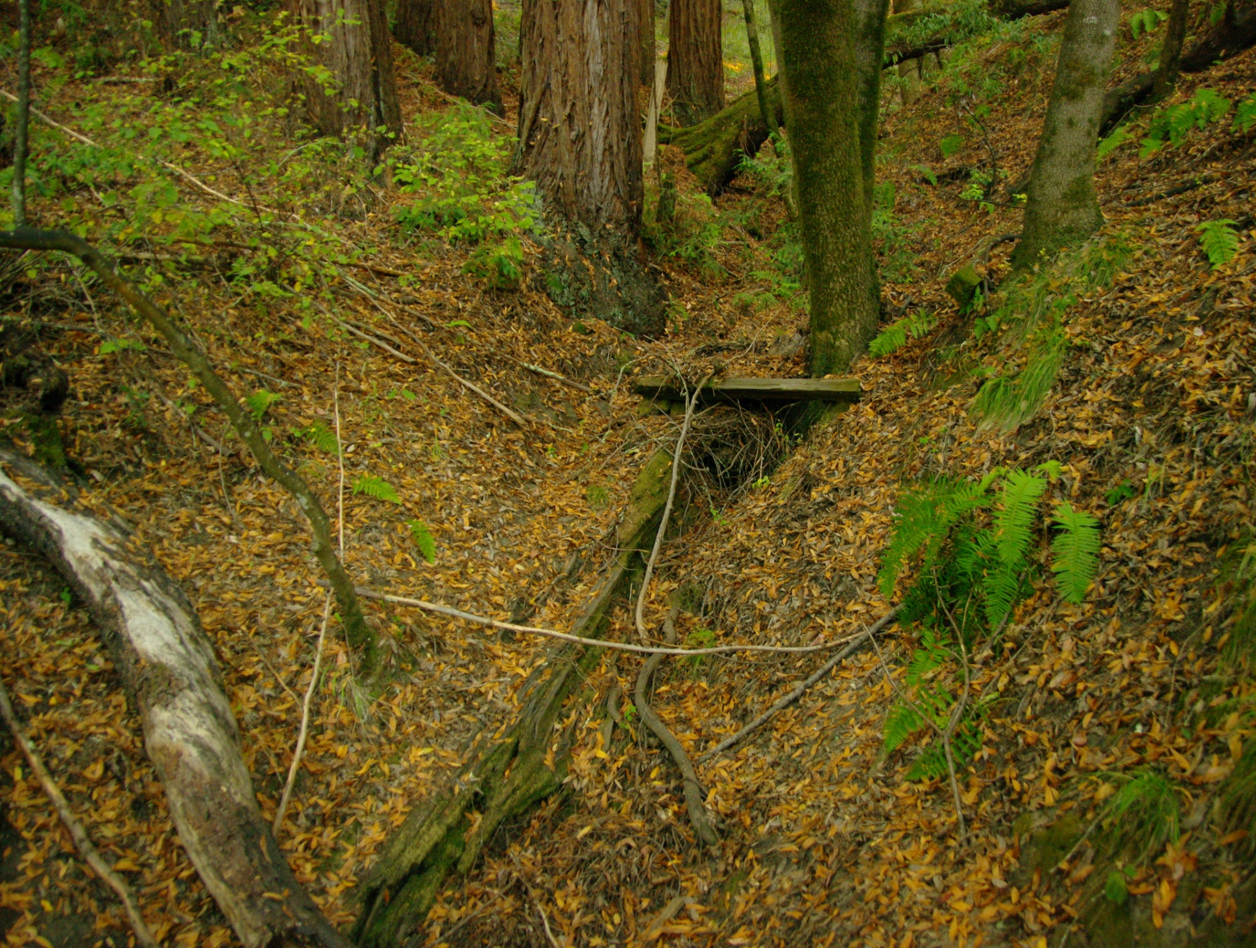
2C
October 2013
Notes:
At the bottom of the slide (viewing from the other side) is this buried log holding the toe of the slide mass. Seed trees of stand #2C are on top but only to the left from which the slide came having bare mineral soil on a north facing slope. From the radius and grain, I estimate the buried log to be pre-colonial. (likely the butt log of “old growth” tree “1”). The oxen dragging it may have hit a snag trying to get it out while plowing into a slide deposit.
The trees on top are 80-100 years old. Hence is the conclusion that road construction above discharged water that cut aggressively through the alluvial slope. That deepening channel caused a series of landslides into this main channel off the side walls of the resulting Gulch. That ended when the County rerouted the road and changed the drainage.

Slide 18
N
Notes:
People have radically altered the drainage regimen and collection areas with roads. When we do that, redwoods can establish on the exposed soils.

Slide 19
2C
October 2013
Notes:
What this also teaches us is that a buried redwood log can hold a lot of dirt for a long time, until the trees on top of it are established and their roots can also inhibit channel incision. So the message here is: Buried redwood logs could be useful!

Slide 20
N
New
Road
Crest
1
1
1
Log
Notes:
So here is what was done about the water that made the Spanish Gulch, I suspect just after that landslide 90 years ago: Mountain Charlie was the first wagon road across these mountains, and remained an important transit route until the Glenwood Highway was opened in 1919. Whoever didn’t like the original grade had heavy equipment instead of sticks and baskets. They cut it much steeper into the rock nose putting the grade crest nearly at the top of the Spanish Gulch. Aerial photographs show that Mountain Charlie was still a dirt road until at least 1963 and was therefore slippery when muddy. So it was hipped inward just like the Spanish trail. That change made the climb up to that crest much steeper, but it didn’t matter so much to gasoline powered vehicles, at least when the ground was dry. The water from the ridge (light blue) then flowed away from the crest into its “natural drainage” (darker blue). Southward, less of the ridge around the nose was collecting water that was sent to a more gentle discharge point with lower slopes. It was an improvement that eventually developed its own minor drawbacks.
In about 1950, the property owner across the road added all the runoff from their pavement and roofs. The resulting lack of percolation sent higher flows down the channel than it had ever supported, thus increasing “channel incision.” Yet between the #1 fairy ring dam, that buried log, and all the wood I’ve dumped in that channel, incision has since been reversed. Look at how the channel incision in our bigger drainage begins at our property line. I will be showing how I used redwood to reverse incision there later on.

Slide 21
N
1
1
1
2
2
2
1
1
1
3?
Notes:
Yet “The Spanish Gulch” remains the key anthropogenic geographical feature on our property as far as redwood is concerned. It not only provided the germination bed for Stand 2, it is the cause of the hollow stems in Stand #1.
A road caused hollow stems? Yup, but not directly.

Slide 22
N
Original Headwall
Original Headwall
Notes:
So despite that there has been no stream here for probably 90 years, continuing erosion is still a problem at the top of the Gulch, now largely due to a lack of vegetation management on an inherently unstable slope.
Do you see these pockets on this south facing slope?
That is called “pit and mound” erosion

Slide 23
N
Original Headwall
Original Headwall
Notes:
And we see a lot of it here. Most of it was probably caused by madrone trees, which (being phototropic) bend toward sunlight much more strongly than oak typically does.
When madrones do fall, they tear out a huge hunk of dirt along with the root ball.
But you can see that there aren’t any of these pits on the north facing side of the Gulch where we have redwoods.
So, if we grow redwood will there be no “pit and mound” erosion?

Slide 24
N
Notes:
No! See these two bigger pits on the next north facing slope?
The LIDAR doesn’t show it well but the top of this slope is really steep, 150-200%. Even though conifers don’t typically lean so much, they too can cause BIGGER pit-and-mound pockets when they finally get heavy enough that a slope that steep can’t take the weight.
Whether redwoods cause slides depends upon the slope. We will go into more detail when we get to Stand #3.

Slide 25
N
1
Notes:
So, now we can finish up with what the Spanish road drainage did to stand #1 to make those hollow redwood stems and it relates directly to those hollow pockets.
There was not only standing fuel, there were dead logs and branches in the bottom.
A fire in there would be horrendous.
The Gulch is so steep it might as well be a chimney. Well, it was.

Slide 26
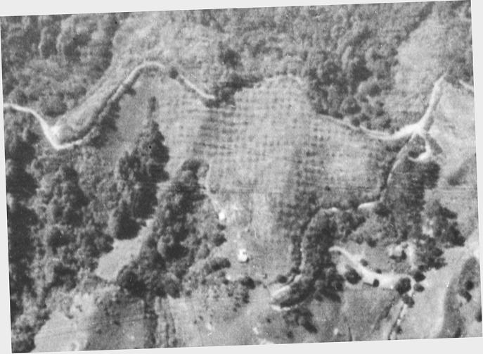
N
Grass
Ceanothus
1
Bay
2
3B
Oak,
Bay &
Madrone
Bay
3A
Oak,
& Bay
3C
Oak,
& Bay
Bay
Image from Flight C-1436 Frame 11, 1931
Courtesy of UCSB Library Geospatial Collection
Image from Flight C-1436 Frame 11, 1931
Courtesy of UCSB Library Geospatial Collection
Image from Flight C-1436 Frame 11, 1931
Courtesy of UCSB Library Geospatial Collection
Notes:
These observations apply directly to what will happen to varying degrees subsequent to the CZU Fires in and around Big Basin State Park as we will develop in Part II of this talk.
By 1931 when this aerial was taken, vegetative succession had continued without abatement for at least forty years after Charlie Martin’s slash fires. This is my estimate of fuel composition at that time, derived from what has grown here since then: bay at the bottom mixed with live oak, tanoak and madrone on the way up, and with Ceanothus and Adenostoma (grease bush) at the top, both of which burn like diesel.
I was told by Charlie Martin’s granddaughter, Margaret Koch, that there had been a fire here in 1941, ten years after this photo. I don’t doubt her, because she was an historian for the Sentinel for many years and wrote more than one book of local history. So this photo, taken ten years before that 1941 fire is a fairly representative of the fuel distribution.
As I said, I cannot get post fire aerial photos because UC Santa Cruz McHenry Library remains closed, supposedly because of COVID. They should ship that collection to Santa Barbara.

Slide 27
N
Grass
Ceanothus
1
Bay
2
3B
Oak,
Bay &
Madrone
Bay
3A
Oak,
& Bay
3C
Oak,
& Bay
Bay
Image from Flight C-1436 Frame 11, 1931
Courtesy of UCSB Library Geospatial Collection
Image from Flight C-1436 Frame 11, 1931
Courtesy of UCSB Library Geospatial Collection
Image from Flight C-1436 Frame 11, 1931
Courtesy of UCSB Library Geospatial Collection
Notes:
As you can see, because of the orchard, most of the fuel on the property was in two drainages, our biggest drainage with the #3 stand and in and around the Spanish Gulch. With the smaller redwood seed trees in stand #1, the bark was still thin enough to leave the trees easily subject to injury from fire, especially toward the tops. The #1 stump clump suffered little damage because they were bigger and at the bottom where there would be less fire draft.
The upper patch of Stand #2 redwood was older and therefore less subject to damage. The lower patch of younger redwoods in Stand #2 are at the bottom of a slope with no fuel below them. Stand #3 consists of three clumps at the bottom of the slope. The bay are coppices now with (drum roll please) a rotting cores! Apparently bay trees do that too. I took a slice off one stump to sand and stain it so that I could date the fire. The ring count was close enough to 1941 that I’m sticking with Margaret Koch’s report.
Let’s take a closer look at the pattern of the fire draft.

Slide 28
N
3B
3B
3B
3A
1
1
1
3C
Notes:
In this immediate area, the terrain is so steep that prevailing winds are deflected by ridges. Grade matters more to the direction of fire draft than do atmospheric winds. It is rare that we get high winds here, but when they do in fire season they come from the northeast which would drive a fire up the Gulch.
The LIDAR image helps us estimate fire draft due to slope. Longer arrows represent stronger draft with orange at ground level and white farther aloft due to longer steep slopes and more volatile fuel: in 6-8” diameter upper stems.
This yellow area, is where I think a fire draft would build a big curling eddy as it came over the top edge of the gulch. This is where the fire entered the redwood crown of Stand #1.
I have little doubt that back-fires (in red) were lit from Ed Fenn’s orchard road and Mountain Charlie, the latter of which had to be scary above the Spanish Gulch.
Now, note this yellow “X” That is where we had a top blow down out of one of a redwood in the winter of 2024.

Slide 29
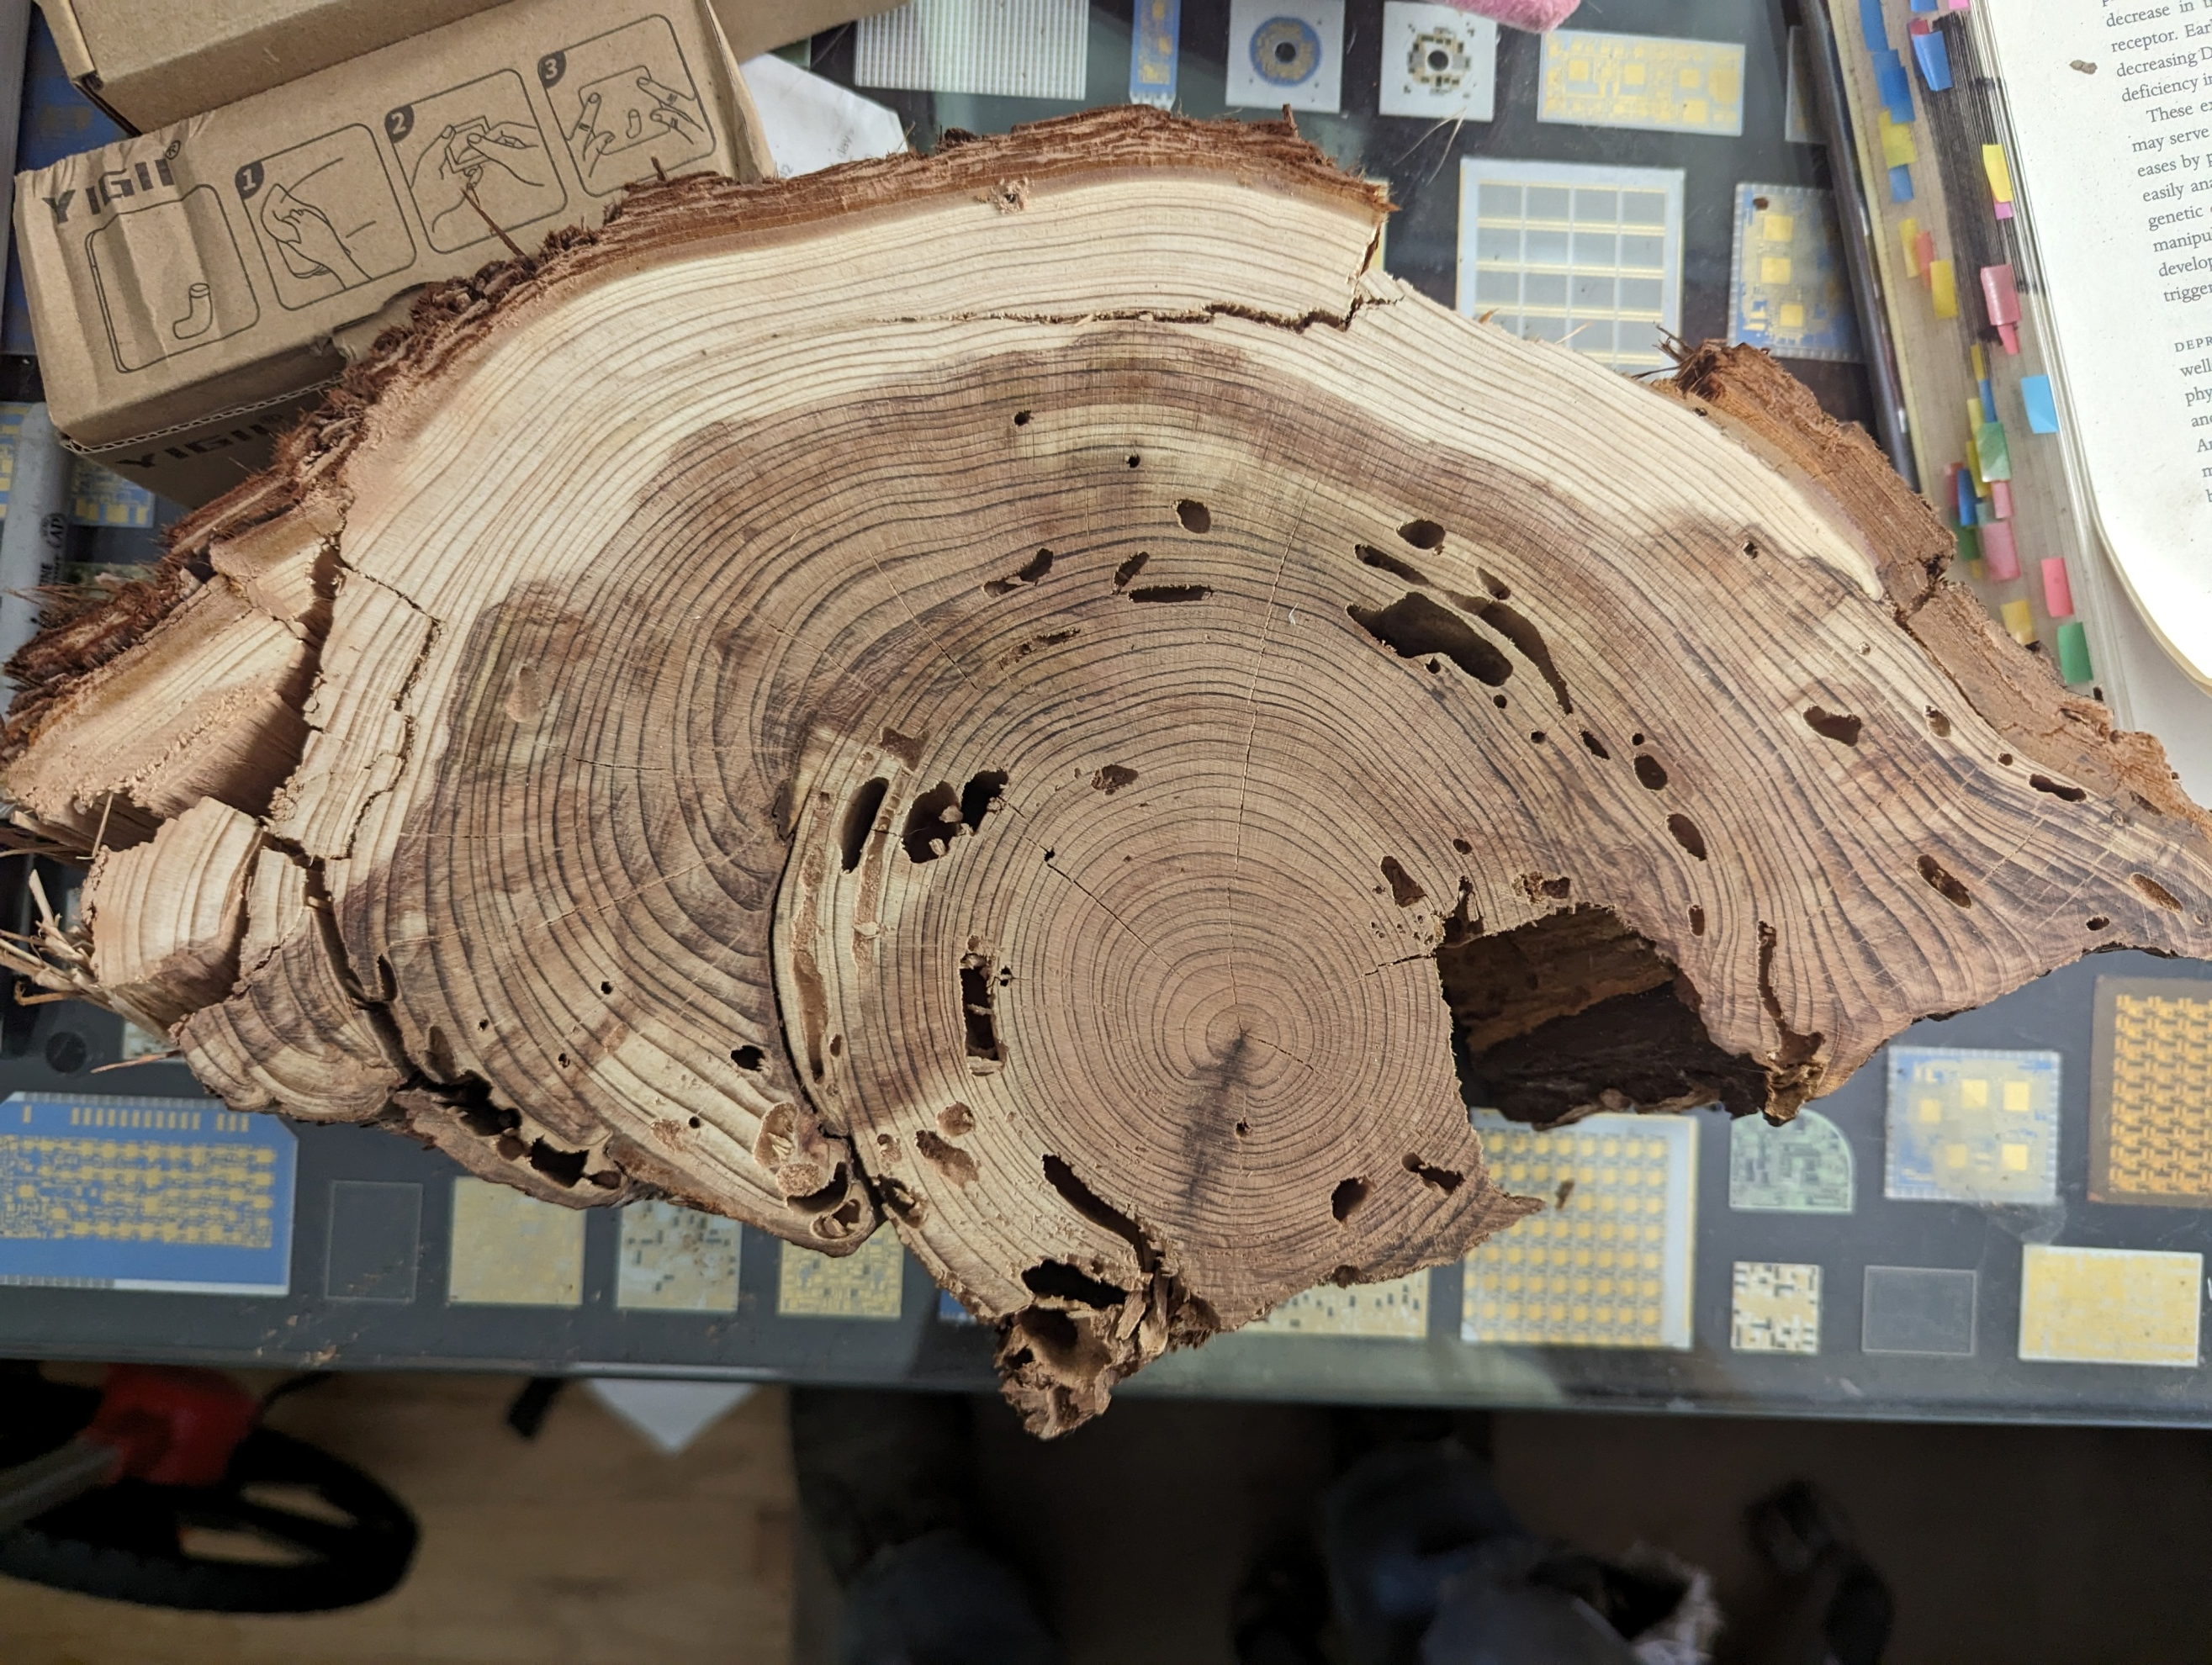
Pre-fire
sapwood
Brown
Rot
Brown
Rot
Pre-fire
heartwood
Notes:
Here is a cross-section of the second top from tree “X” to illustrate the dominant recovery mode of a redwood top injured by fire.
I will be covering this post-fire decay mode in detail in Part II of this talk.
In a crown fire, the higher on the tree the worse the damage usually is because that’s where the fuel is, heat rises, and the bark is thinner there. There also isn’t much heartwood nor is it as densely packed with decay resistant chemicals to defend against pests and brown rot, which here infuses most of this stem.
The core section represents a stem that was about 30 years old at this height on a seed tree about 60 years old when it burned. You wouldn’t want to use this for lumber, would you? There’s no wondering why it blew down is there?

Slide 30
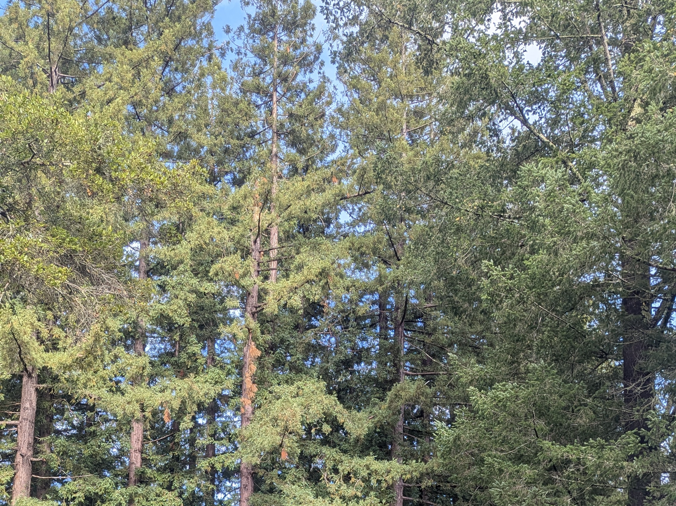
Breaking
Point
January 2025
Notes:
The tree had double tops that now have both come down, broken off at the same point.
So, what happens with this tree now is obviously up to me. It’s not worth any money because of the internal rot. So if I cut it and deal with it, it’s going to cost a lot of time to buck split and burn it and then deal with the stump sprouts. But at least I’ll get cores to confirm the date of that fire and estimate its severity more accurately as I sample trees from this stand in order to avoid repeating what caused this problem. Is that information worth anything? Not the way we run things now.
So the question remains what to do with it versus what if I don’t do anything? Do I keep it as a sacrificial layer to protect the stand or would that add heat to a fire from the Gulch? If I leave it, this stem will put up multiple leaders from here. Perhaps one of them will become a central leader but it will likely be more. But no matter what, a leader from this point will start out growing outward from a rotten core then to turn up. Once those stems get bigger they break off, and keep doing that, then becoming reiterated trees. There’s no room for one here.

Slide 31
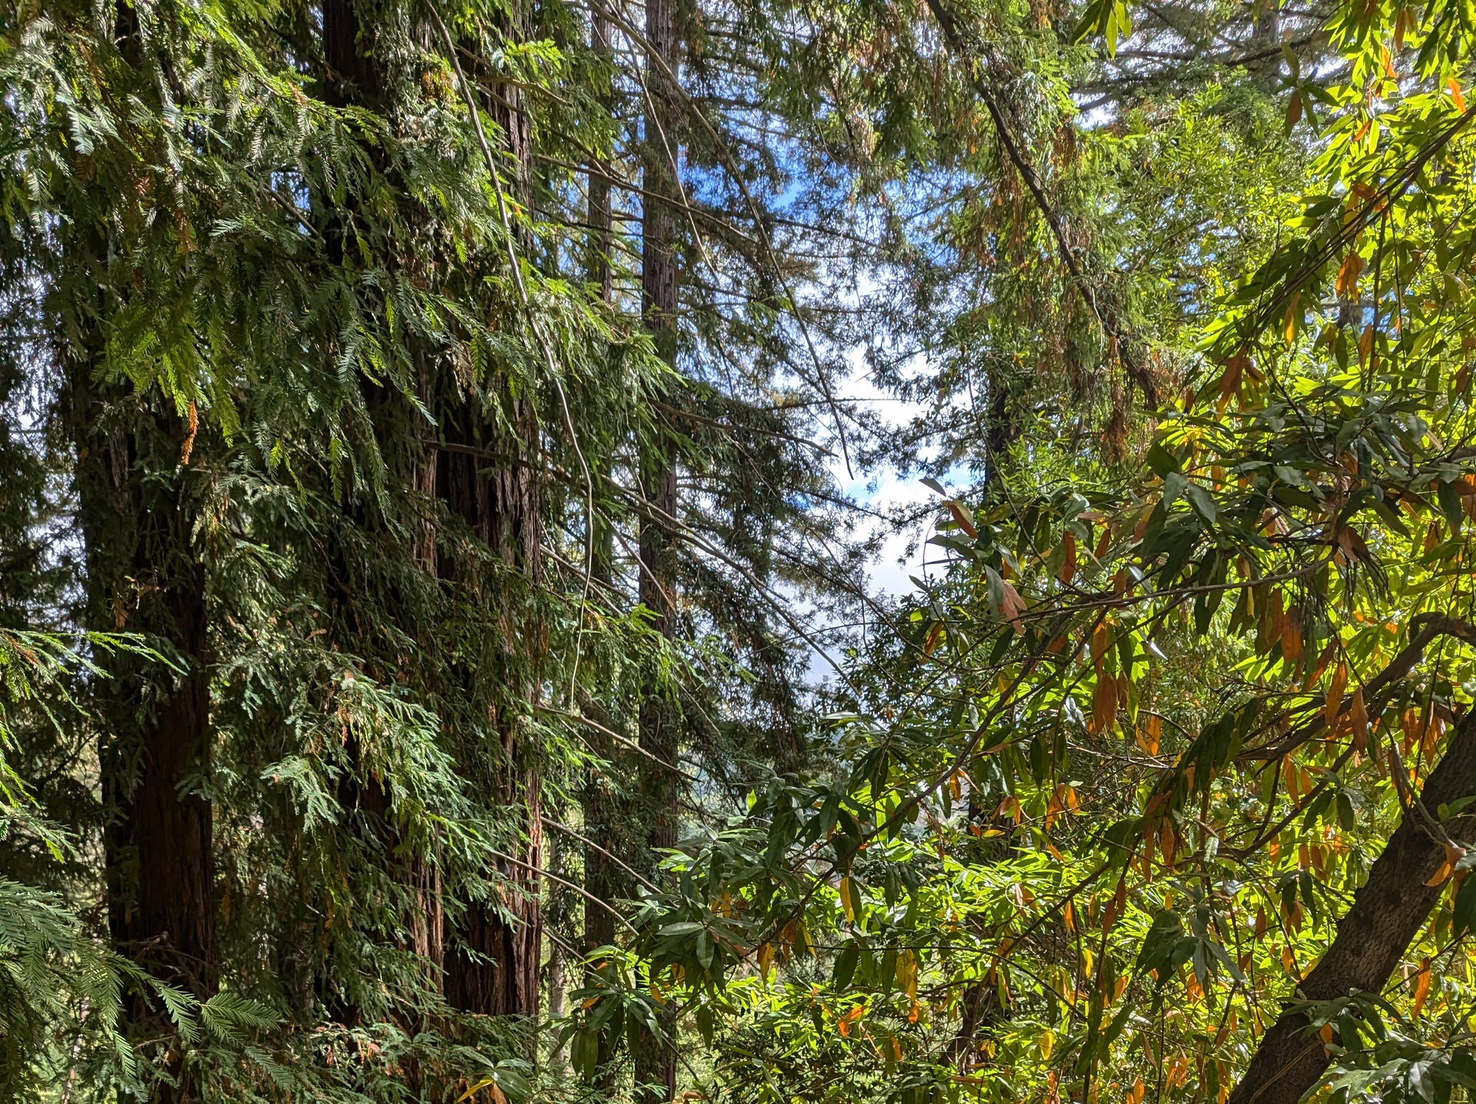
September 2025
Notes:
A fire has to first dry the needles, and then they catch fire. So if a wimpy ground fire goes by and is done before the needles dry, that bushy top would be protective to the rest of the stand. If it’s hot enough to dry the top, AND if the flames are still high enough to ignite them, then the top becomes fuel to start a crown fire. So the key to making it protective is to control fuel along this southeastern outside edge of the stand to keep the fire on the ground.
This is easier said than done. When starting a shaded fuel break, one doesn’t have much of a choice regarding sources of shade. In this case, I had to start with a bay tree at the top of the slope.

Slide 32
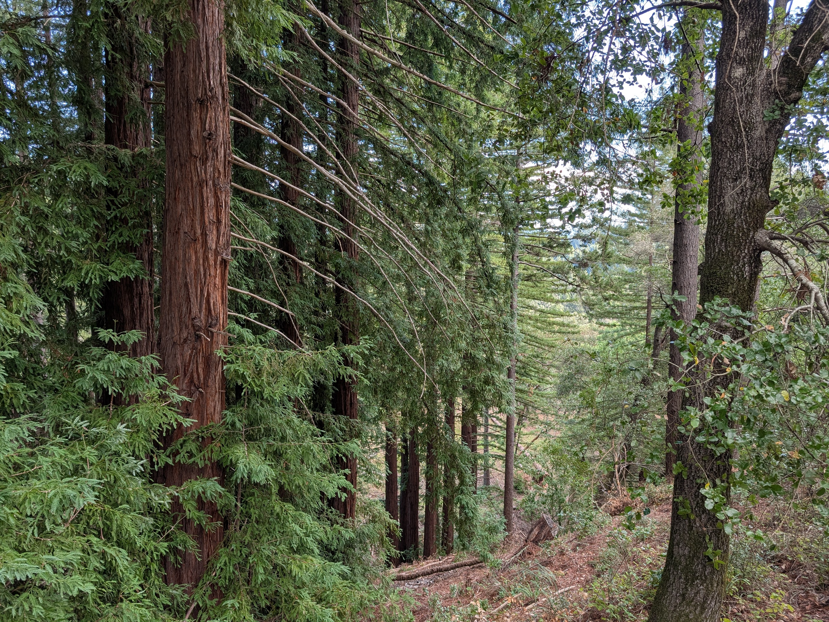
March 2026
Notes:
When one clears along the edge of a redwood stand, as I had done here ten years previously, the light stimulates new branches that hang downward toward the ground, thus making their own ladder fuels. I’ve seen them hang 30ft to within a couple of feet to the ground.
This last winter I started putting burn piles under those branches to cook them back, effectively taking the risk that a fire won’t ignite the piles before then. I tried some that were higher than these first to learn more about the behavior of the heat column. As I take down some of these trees, I’ll make more piles from the tops.
As to “cooking” them to 30ft just after a rainstorm, that takes a larger pile of some 8ft of more, particularly because it is the initial flare consuming fine fuels that does the job of extending the flames to increase the heat column higher up. Using a blower to get it going quickly helps there, a LOT. The first pile I did was successful up to about 20ft. Without winds it might have worked to 30ft which was the goal in this stand. Winds can drive the heat column all over the place failing to allow sufficient time to cook the drooping ladder fuels, as the branches must get to over 60 °C (140 °F) to kill the cambium cells. Else they will sprout new branches just like the stems do after a major fire.

Slide 33
N
Image from Flight C-1436 Frame 11, 1931
Courtesy of UCSB Library Geospatial Collection
Image from Flight C-1436 Frame 11, 1931
Courtesy of UCSB Library Geospatial Collection
Image from Flight C-1436 Frame 11, 1931
Courtesy of UCSB Library Geospatial Collection
Notes:
So the key to protecting our stand #1 is to keep fires at low intensity closer to the ground: a shaded fuel break.
The other key is to deter the growth of those drooping branches, and the two activities are doable at the same time by degrees, but whether the fuel supply rate matches the size and frequency of fire needed to burn back drooping branches nobody knows.

Slide 34
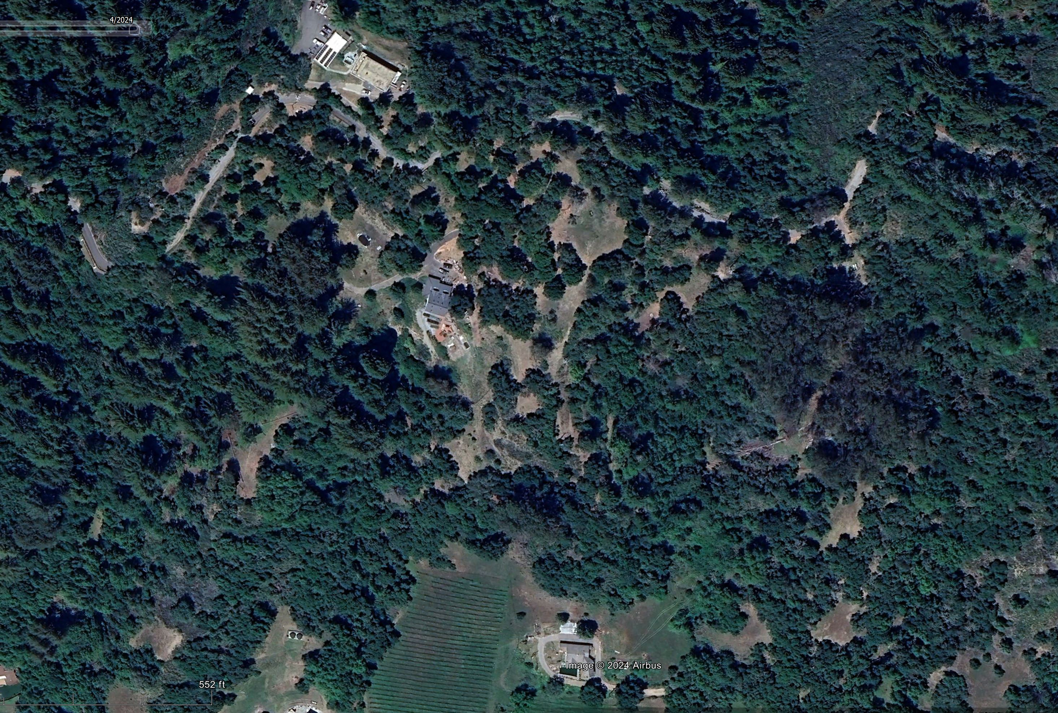
Dr. Henri Grissino-Mayer at UTenn, Knoxville is a dendrochronologist.
N
2014
1
2015
2022
1
2000
1
2025
1
2010
2022
2015
May 2023 – Google Earth Screen Capture
Notes:
The idea of a shaded fuel break is to maintain an elevated canopy producing shade to inhibit the growth of ladder fuels. Best to have said canopy also comprised of species with lower fuel value. In terms of fuel removal, you have to start with the catastrophic, move onto the merely hazardous, then the remedial, and finally the preventative. I had a lot of catastrophic.
Sometimes, depending upon what one has for a canopy, you can’t have both shade and low fuel value shade right away.
In previous years, the only areas I had NOT thinned beyond removing suckers are the areas inside yellow dotted lines: the redwoods inside these two ellipses, the redwood in the lower half of Stand 1, and to the south of the dotted yellow lines. In addition to that, I removed almost all seedling tanoak trees and most of the small crown sprouts in Stand #1 this year. Most of these numbers represent only the most recent entry, several have been thinned multiple times under a program I call “Phased Forestry” described on the Wildergarten Picture book on my web site, Wildergarten.org.

Slide 35
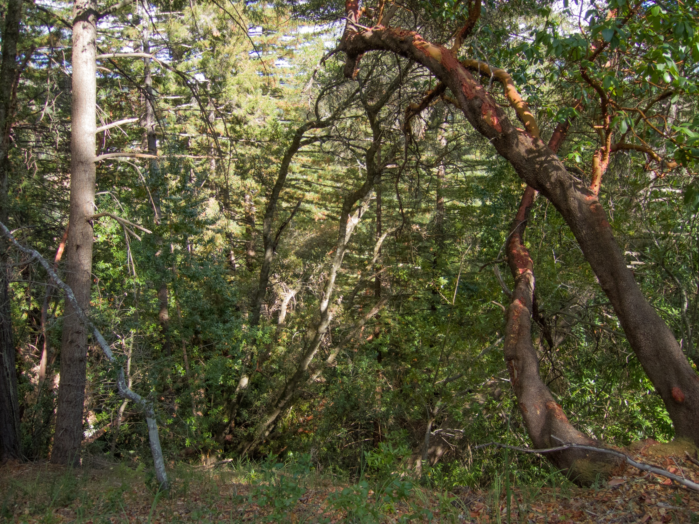
November 2015
Notes:
This was the “catastrophic” on this slope in 2015 before I cut the shaded fuel break, looking down along the southern edge of the redwood stand.
The north edge of the Spanish Gulch is 60-80ft to the right.
That tree marked with an X is a fir directly adjacent to the edge of the redwood stand to the left.
Needless to say, this fuel accumulation in 2015 was a LOT worse than in 1941

Slide 36
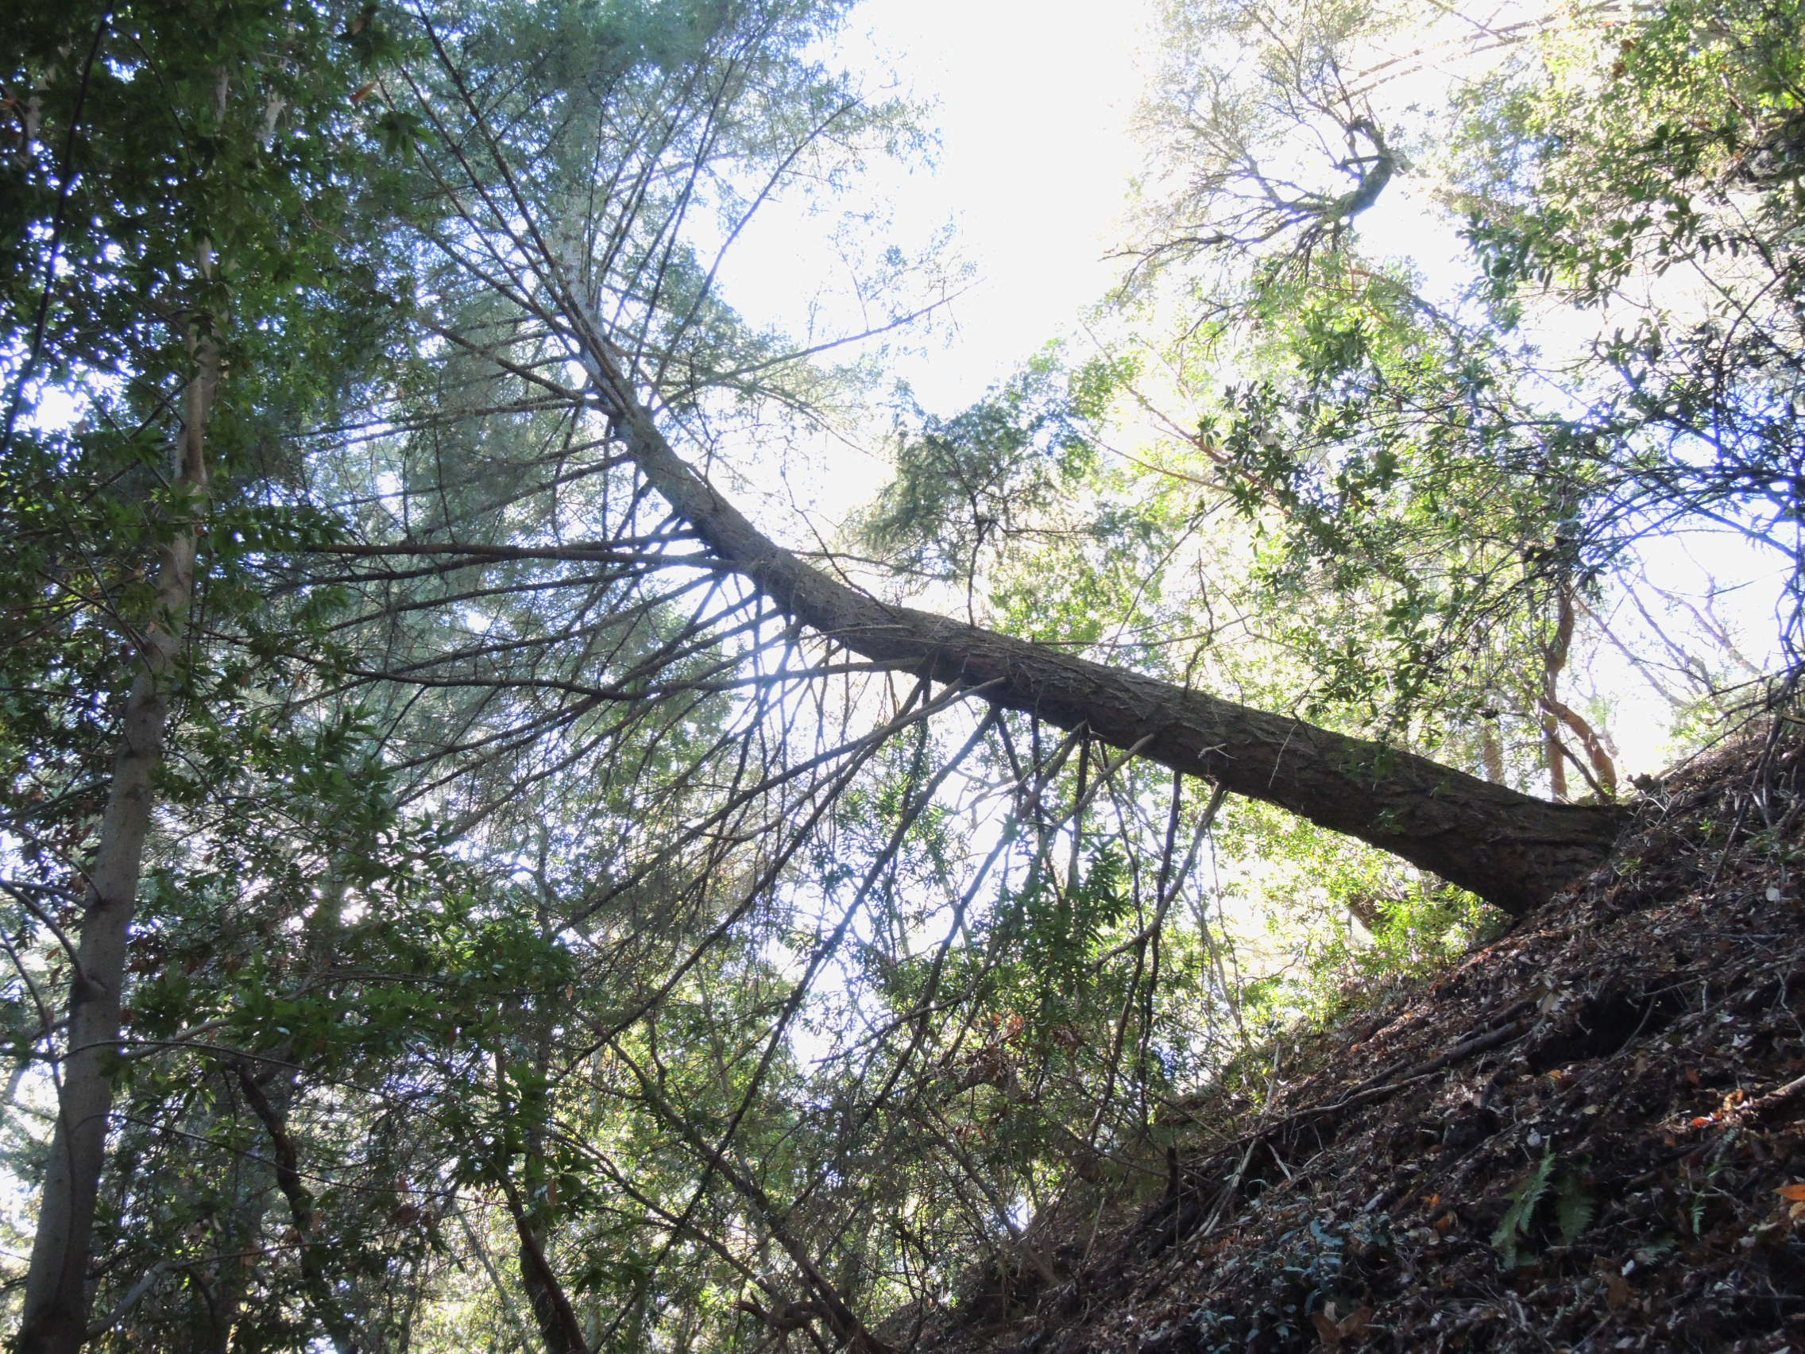
November 2015
Notes:
The job had its challenges. This is a fir tree that had almost fallen, starting out at about 45° to the slope but bent back toward vertical as it grew. It was about 28” where I cut it.
Nobody wants wood from a tree like this. Besides all the big knots, the stress in the wood resisting gravity is so strong it turns into a pretzel as it’s milled. It’s not even good firewood and getting the wood out of there is very difficult. So there is no way to offset the cost of getting rid of it unless somebody cared about the risk all this fuel posed just below an evacuation route.
The first big challenge is dropping it without getting killed by a flap breaking off and slapping the faller, leaving what’s called a “barber chair” and an injured or dead faller.
I didn’t have much of a choice as to where it would go. It dropped into the Gulch.

Slide 37
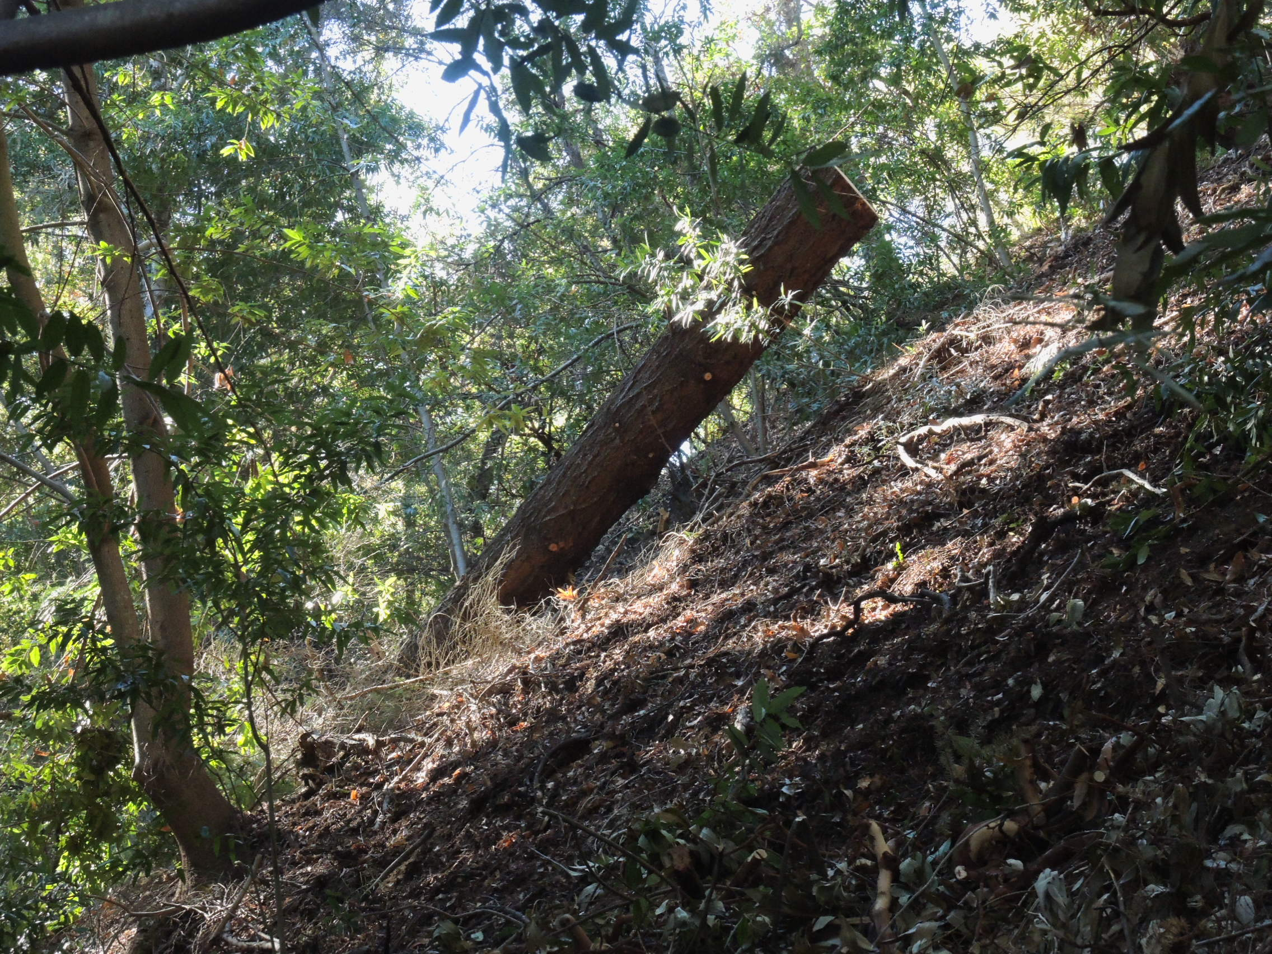
November 2015
Notes:
Did I tell you the Gulch sidewalls are steep?
Bucking a log on a slope like this by yourself is a real thrill.

Slide 38
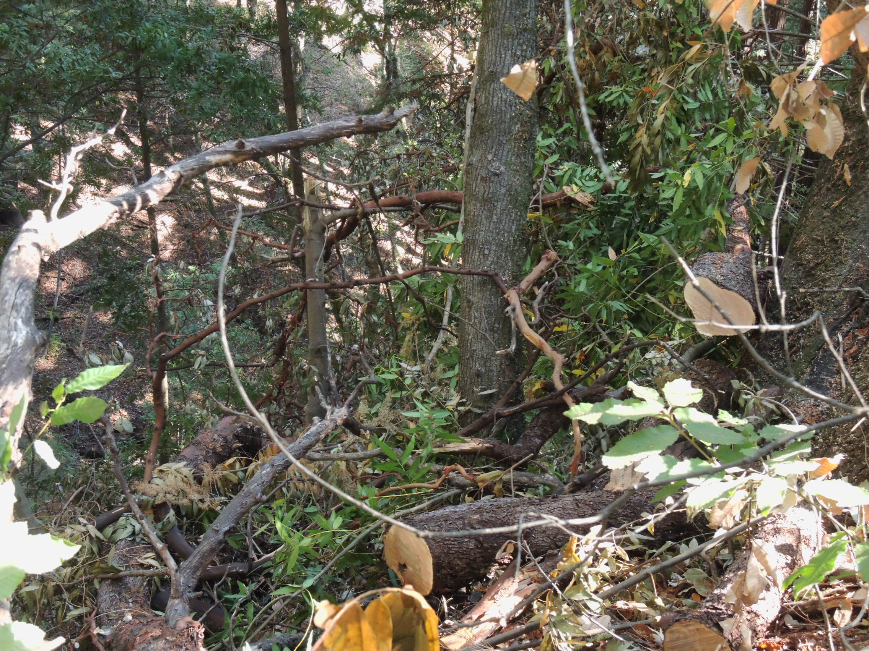
November 2015
Notes:
Did I say this is steep? I yarded the material toward the top with a block in one of the firs I had kept for that purpose as a spar tree.
I do this kind of thinning in phases to minimize the weed response and increase the rate at which the wood rots. This is what I call a Phase 2 thinning, designed to start a native groundcover, but not much more.

Slide 39
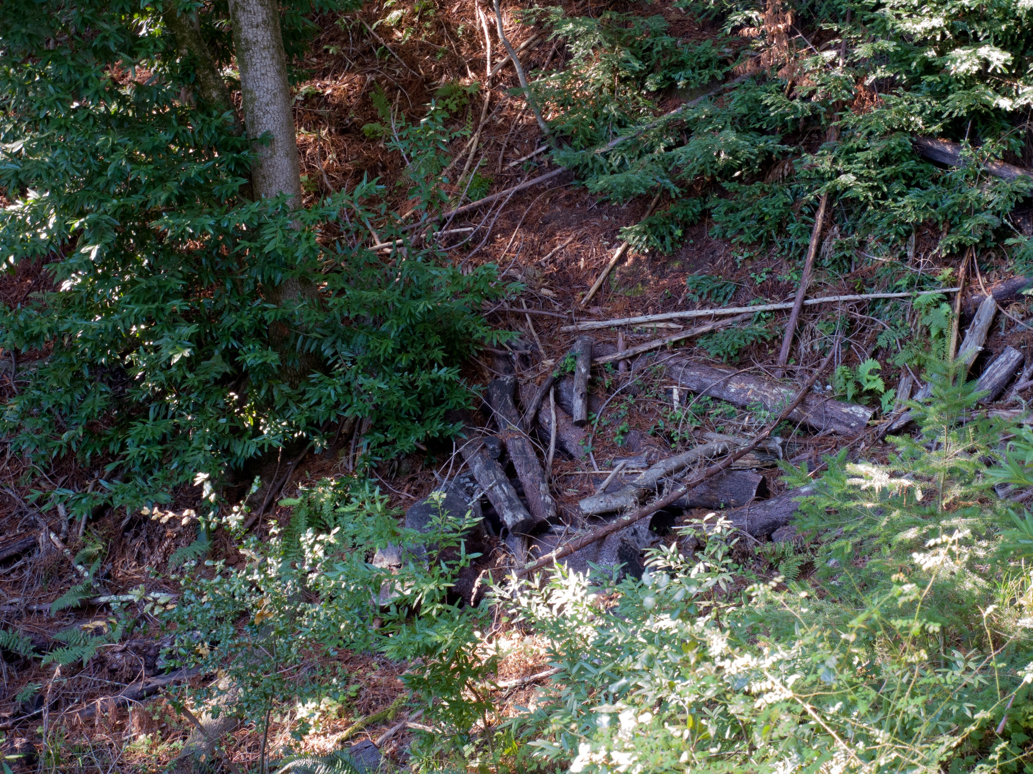
March 2022
Notes:
Most of the wood went downhill to the drainage.
Most of what you see here was dead madrone, which is dense and rots very slowly. These are a way up the sidewall, and are thus unlikely to form a debris flow.
If there is a fire here, this material would burn for days, thus making it unlikely CalFire would want to conduct a prescribed burn from the top down without a way to stop it before it gets here. It should be run from the bottom up, but they don’t like to do that.
I am concerned that a fire in the redwood might induce a ton of redwood seedlings anyway. So broadcast burning here is out for now.

Slide 40
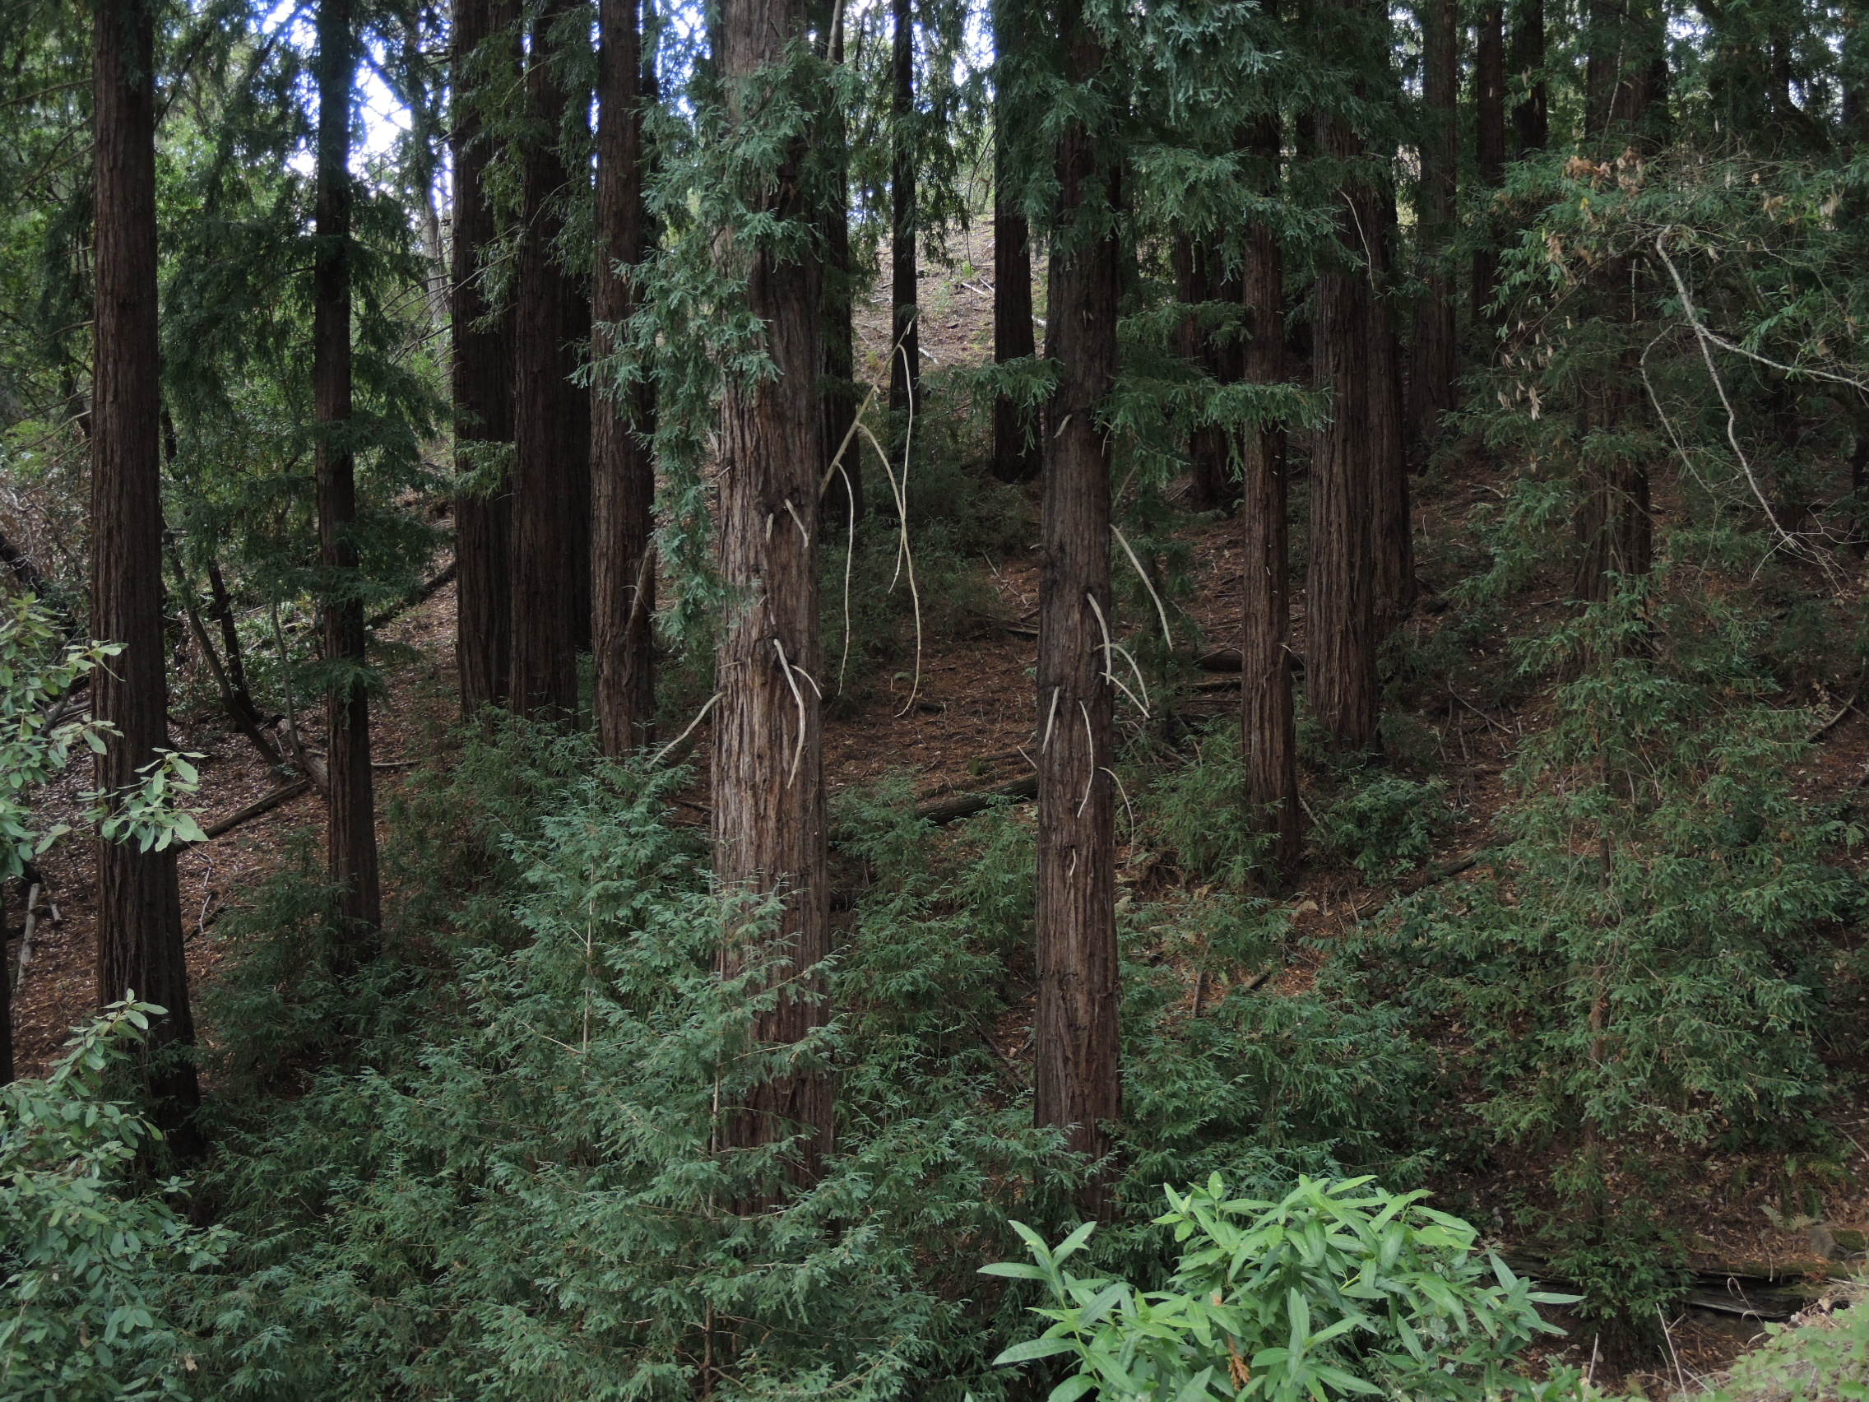
December 2015
Notes:
You can see from the light on the outside of the stand that after the first thinning ten years ago took out a lot of material, but unfortunately, most of the shade trees left were either fir or bay. Both burn like hell, and both grow fast.
You don’t always get your preferences in shade trees. One must establish those alternatives to make the transition.

Slide 41
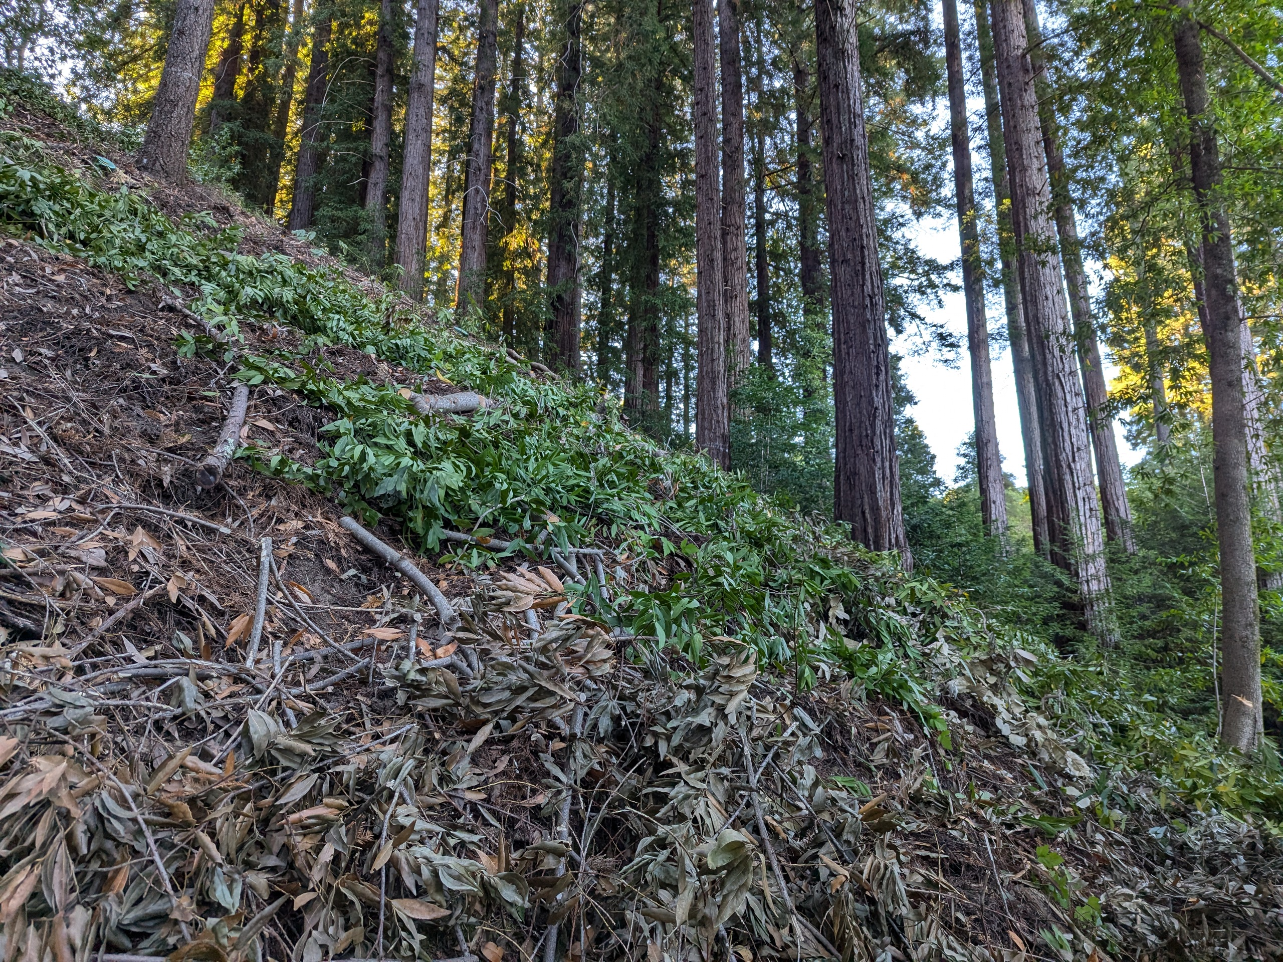
September 2025
Notes:
In 2025 I got the bay and left a very few tanoaks which will have to be removed next time. Working here was perilous, in that one can start sliding down the hill while just trying to stand on it, never mind while swinging a chainsaw. I want to get out more conifers, but we’ll see if I get that far. It may be next year.
I’m thinking of planting maple but I don’t know how much light it would need on a north facing slope this steep. There is also the risk of a shot-hole borer infestation, as those were introduced to the area recently. I may try dogwood here, as they are receding, I suspect due to a warming climate inhibiting cold stratification of the seed.
I’m going to remove about 25% of these redwoods and we’ll get to what will happen later in the talk.

Slide 42
Dr. Henri Grissino-Mayer at UTenn, Knoxville is a dendrochronologist.
N
1
Yet to be
Thinned
2015
Redwood
Yet to be
Thinned
1
1
2025
1
May 2023 – Google Earth Screen Capture
Notes:
Although the Shaded Fuel Break more than doubled in area this year, the fuel in the Spanish Gulch is still nasty at the top. I have thinned it at the bottom and along the left edge of the redwood stand on a neighbor’s property but not enough to offset the hazard to a fire evacuation on Mountain Charlie. I need to cut back brush on the Gulch headwall, start sedges coming down from the top edge, and slowly remove fir, some bay, and the trees at the top. Stabilizing fuels on steep slopes is a gradual process.
The reasons I haven’t finished yet are threefold:
1 It is so steep I will need to be on a rope to cut that material and to plant the sedges, for which I would need help
2 My neighbor dumps weeds on me from off that ridge above and I’d have to weed that nearly vertical wall every year.
3 At the age of 72, I haven’t got that far.

Slide 43
N
1
3
2
1
3?
3?
May 2023 – Google Earth Screen Capture
Notes:
We’re now done with redwood stands 1 & 2
Stand #3 is very different, in that it is where I think pre-colonial tree #3 once stood, but I’m not sure exactly where or exactly when it came down. It did go down, and it wasn’t logged and that teaches us a couple of very important ideas about managing landscapes with redwood.
Redwoods both inhibit and accelerate erosion. It is effectively a leveling factor. It can be used that way too.

Slide 44
N
1
B
36”
24”
3?
A
24“ 18”
1
1
3?
4 X 48”
C
Notes:
Stand #3 consists of three clumps of trees growing near the bottom of the north facing side of a spur from the main ridge that comes down to the left in gray. I’ll call these three clumps A, B, and C in the order they’ll be discussed. Again, the blue lines are seasonal drainages with the ridge spur between Stands 1 & 3 in white.
When we got here, there were 8 stumps that had made these three clumps, all of which had been logged and burned by Charlie Martin’s people between 1880-90. I’ve marked each with their respective sizes. NONE of the stumps in these clumps is bigger than 48.” ALL were likely post-colonial trees but they obviously predated American invasion. The oldest were approximately the same age as the Stand #2 trees in the Spanish Gulch, but the reason these were logged was that there was likely the much better access to them from the Town of Glenwood. The vestiges of a logging road are present below them.
I believe there was an old growth tree here that was the source of this stand. So let’s look at the clusters to infer where pre-colonial tree #3 might have stood (#2 being south of the property).

Slide 45
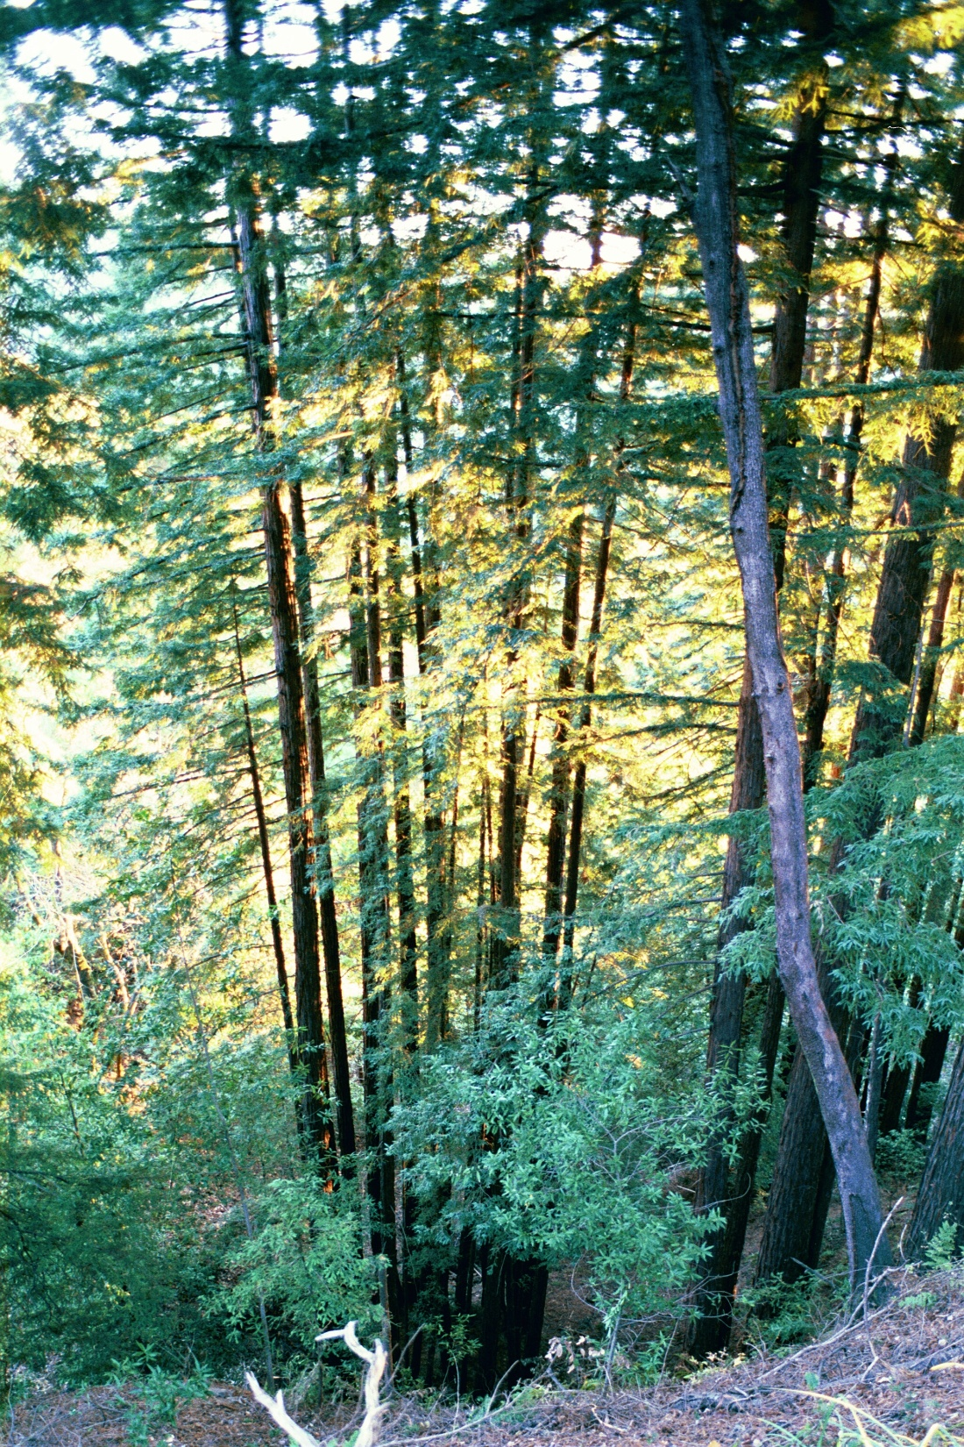
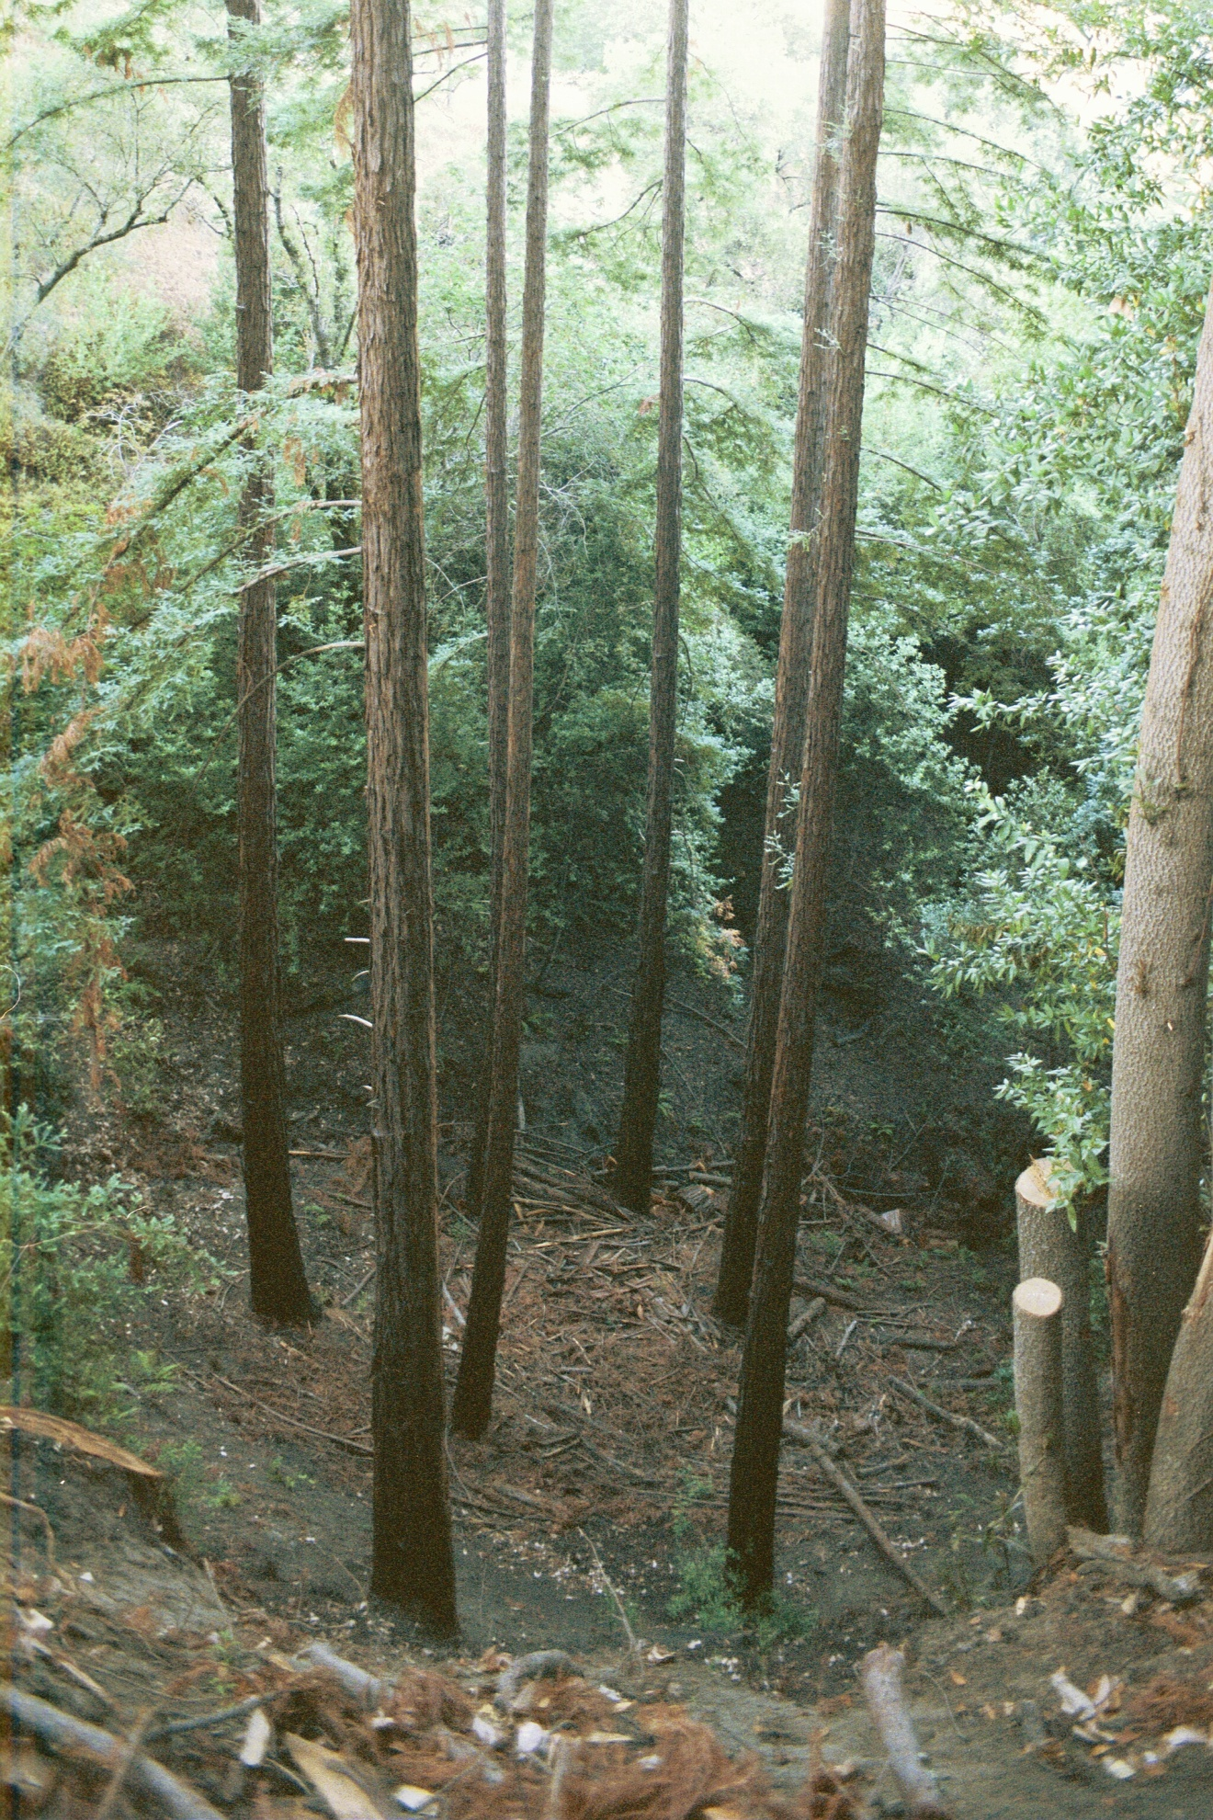
2
1
3
6
4
A
5
X
A
Trees felled
this way
Trees felled
this way
April 2000
Trees felled
this way
October 1999
Notes:
Originally, Clump A was two stems when they were first logged in about 1880. One was about 24” and the other 18”. Obviously at that size, these were not pre-colonial “old growth.”
By 2000, Clump A was a wad of 31 crown sprouts on the left. I thinned it in order to learn about logging for my first book, Natural Process, as I’m not a fan of expressing opinions about subjects as emotionally controversial as logging redwood unless I’ve done it myself. So this was an exercise for writing the book. I had the great privilege of working with Steve Liebenberg on this project, whose family has been logging in these mountains since the 1940s. It was just the two of us. I was the choker setter and I processed all the tops. It was exhausting.
Note that the double stump that started this Clump A is not there at right. That’s because I had dug it out with a Pulaski and a shovel, removing about ten yards of that 24” stump clump hump so that the water could be diverted through the middle of the clump. After I chopped a LOT of roots, Steve and I popped out the stumps with a 5/8 double block and tackle and a loader over 100ft above on the spur. That experiment later failed for reasons you now know that the crown sprouts captured so much sediment as to return the flow to the original channel. I’ll try a stump grinder chewing out the sprouts to fix it. Meanwhile, we learned something important as a result of this job.
When Steve pulled the stumps out what I found underneath was the log from which that double stump had apparently sprouted. It had been covered by a landslide. Buried redwood logs can last a long time. I’ll bet there are a lot of them in these Mountains.

Slide 46
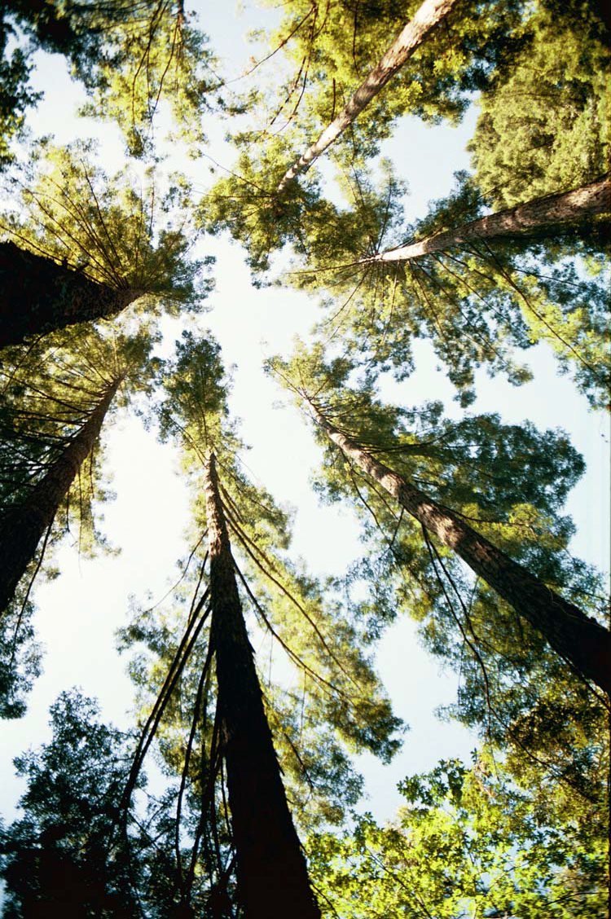
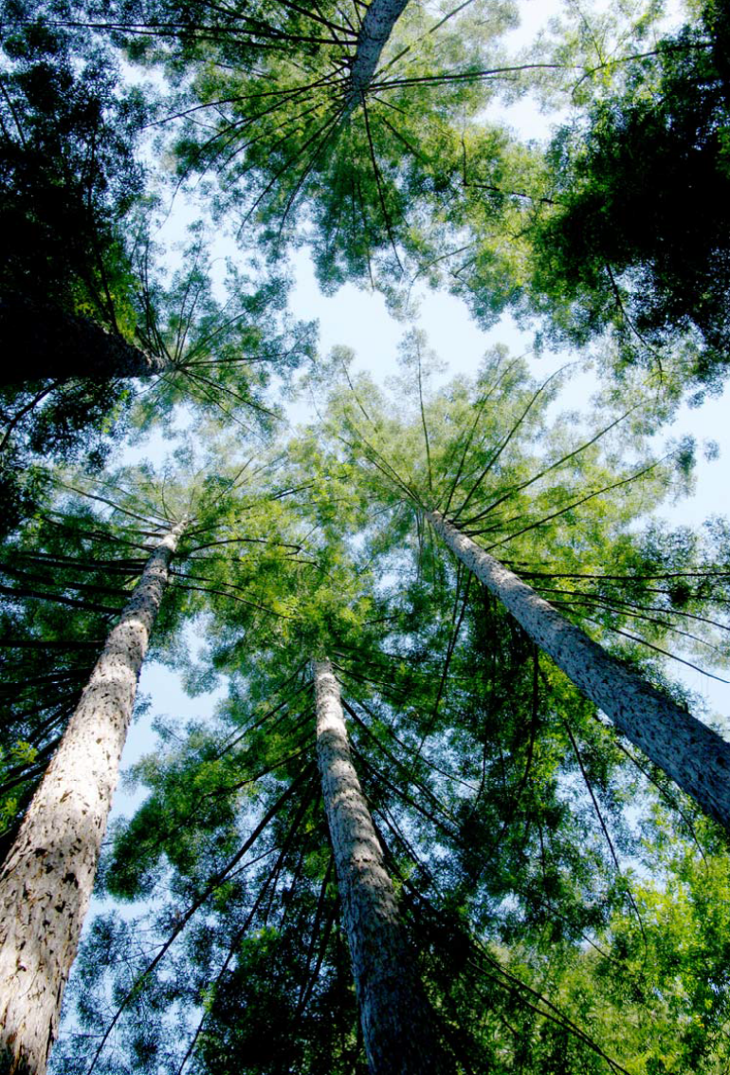
6
6
1
1
5
5
4
4
2
2
3
3
April 2000
May 2009
Notes:
So after logging Clump A, what had been 31 stems was now the six biggest. So things are looking up!
See how beaten up they were from crowding, wind shear, and collision?
This is typical of trees from a stump clump, and this one had been burned!!!
At right is the recovery of Clump A after only 9 years.
Look at #5 how it straightened. Isn’t that amazing?
They put on a lot of weight too, but I don’t necessarily want them growing that fast.
They do sway more, which hardens the wood if they don’t break. We have trade-offs between rate of growth, symmetry and straightness, ring density, strength, and fire resilience,

Slide 47
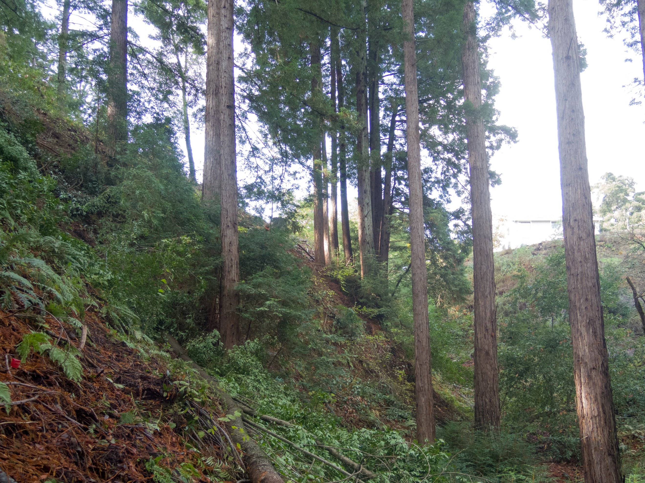

B
A
X
5
November 2017
Notes:
See how the slope is hollowed out on the left?

Slide 48
2?
3?
3?
X
5
November 2017
Notes:
It’s like a big pocket taken out of the slope.
Geologists call a slide like this a “rotational failure,” again “pit and mound” erosion writ larger. Just below the scarp above is one candidate for where pre-colonial tree #2 may have stood but there is another possible location.

Slide 49
B
36”
24”
N
3
3?
3
A
24“ 18”
3?
4 X 48”
C
Notes:
In the LIDAR image, you can see the edge of the scarp from that slide and another farther down the ridge.
The scarp edges are here in yellow.

Slide 50
B
36”
24”
N
3
3?
3
A
#2 Log
24“ 18”
3?
4 X 48”
C
Notes:
This green diagonal line represents the orientation of a buried log I found when I dug out that stump but I do not know how far it extends or in which direction. So this represents a hypothetical case in which pre-colonial tree #2 got large enough to induce a slope failure but I’m not sure which of these two possibilities represents that stem’s location. The problem with the hypothesis is that a rock blob on which clump B stands is too steep to have been caused by a slide. Stumps B are bigger than A, but not as big as C, indicating that it may have come before Clump A. BUT, there is that second scarp just above them.
So, was there an event that took down two trees? There was a major earthquake estimated to be in about 1790 but that should show up in Spanish records, but to my knowledge it does not. It was before the Mission was built there. Whether it was a rain event or some other cause, when pre-colonial tree #3 came down, the landslide came with it and buried the log. Because it was a conifer, it made a larger “pit.” I estimate that the earliest date these two trees had germinated was some time around 1800-1820, 60-80 years before they were logged, and 10-20 years after the 1793 Spanish burn ban, but it’s just a guess.

Slide 51

B
October 2013
Notes:
So here is Clump B as seen though Clump A. The stems are divided almost evenly into two groups, upslope and down with the larger diameters on the downhill side and leaning outward along with most of their growth having no support under them.
The big structural problem with this clump is that the slope below is nearly vertical. In other words, this clump has high windage and lots of weight leaning outward from the hill, having no support.
Does anybody doubt what will happen here if these trees get big enough? This is a rotational failure landslide waiting to happen. Just like pre-colonial tree #2 did less than 100’ away.
If it goes, there is no telling which way the stems will go. They could reach the house

Slide 52
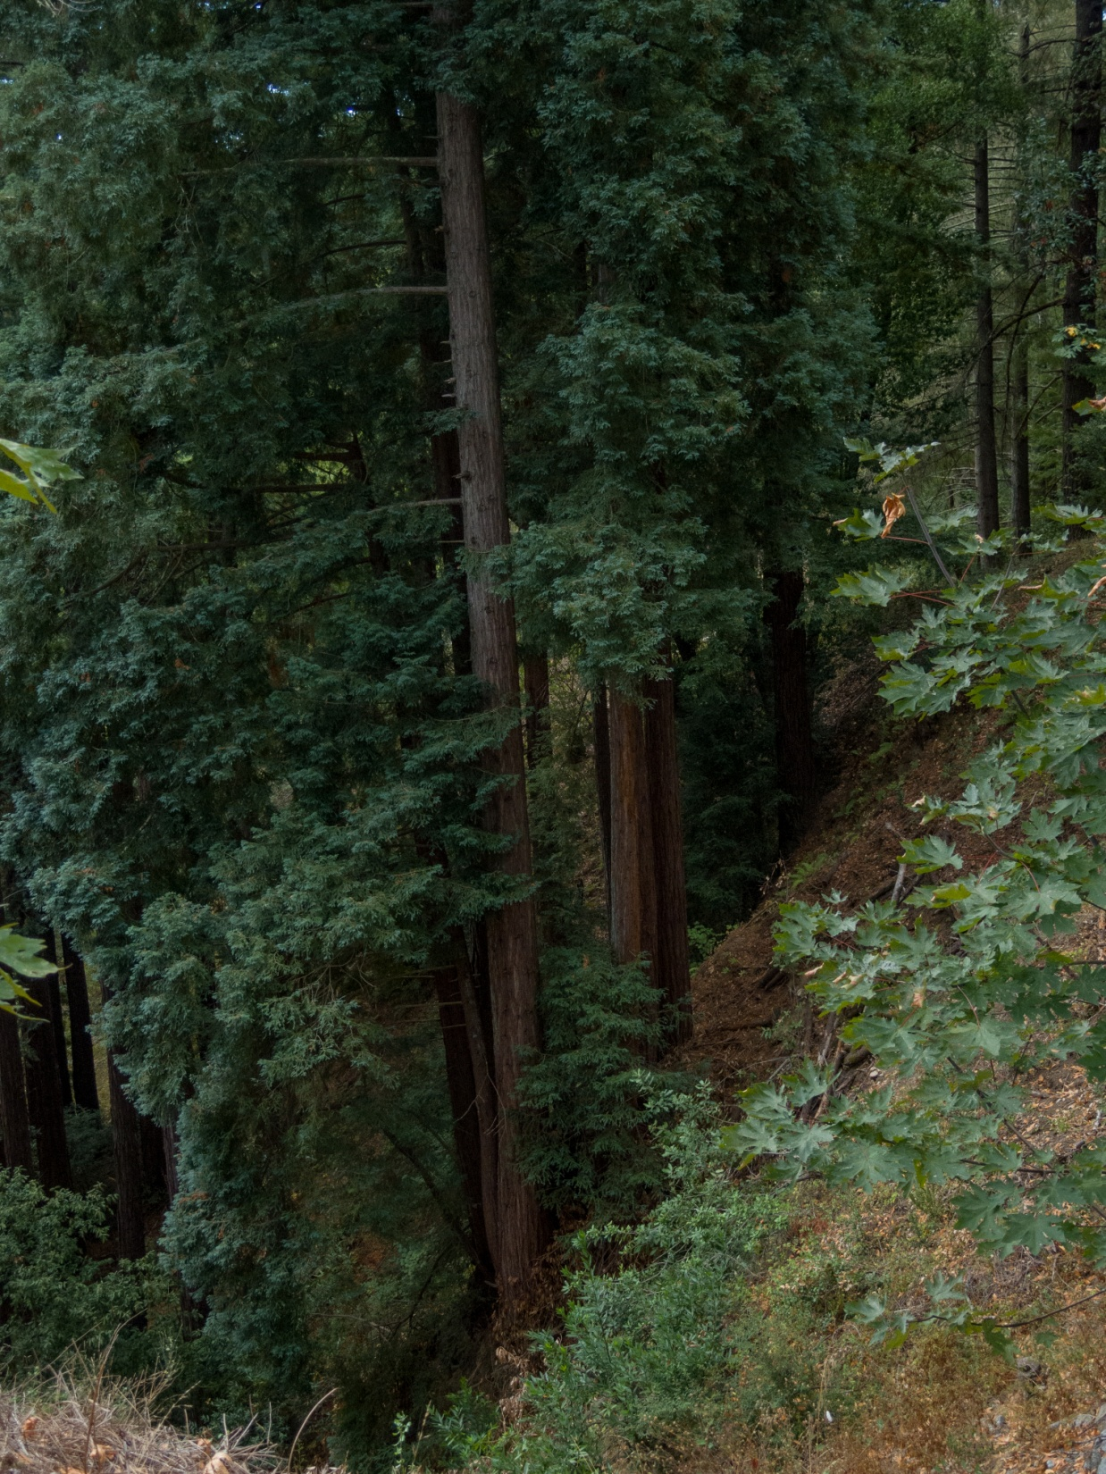
B
March 2022
Notes:
This is Clump B from the other side seen from up by the house. It’s on a slope of some 150% above (rise over run), so it is a hazardous clamber just to get down there. Last time I went in there to remove junk, there were 14 stems off those two stumps
I’m not going into what is involved in doing anything about it because that is logging and not ecology. Unfortunately, the way the regulations are applied here, they aren’t about ecology either.
I want to take all of the outside stems, but I’m told I can’t do that because the officer involved is calling this one clump a “stand.” It’s just two trees that made this mess. Two trees do not make a stand.
So I hope to get off Scott free.

Slide 53
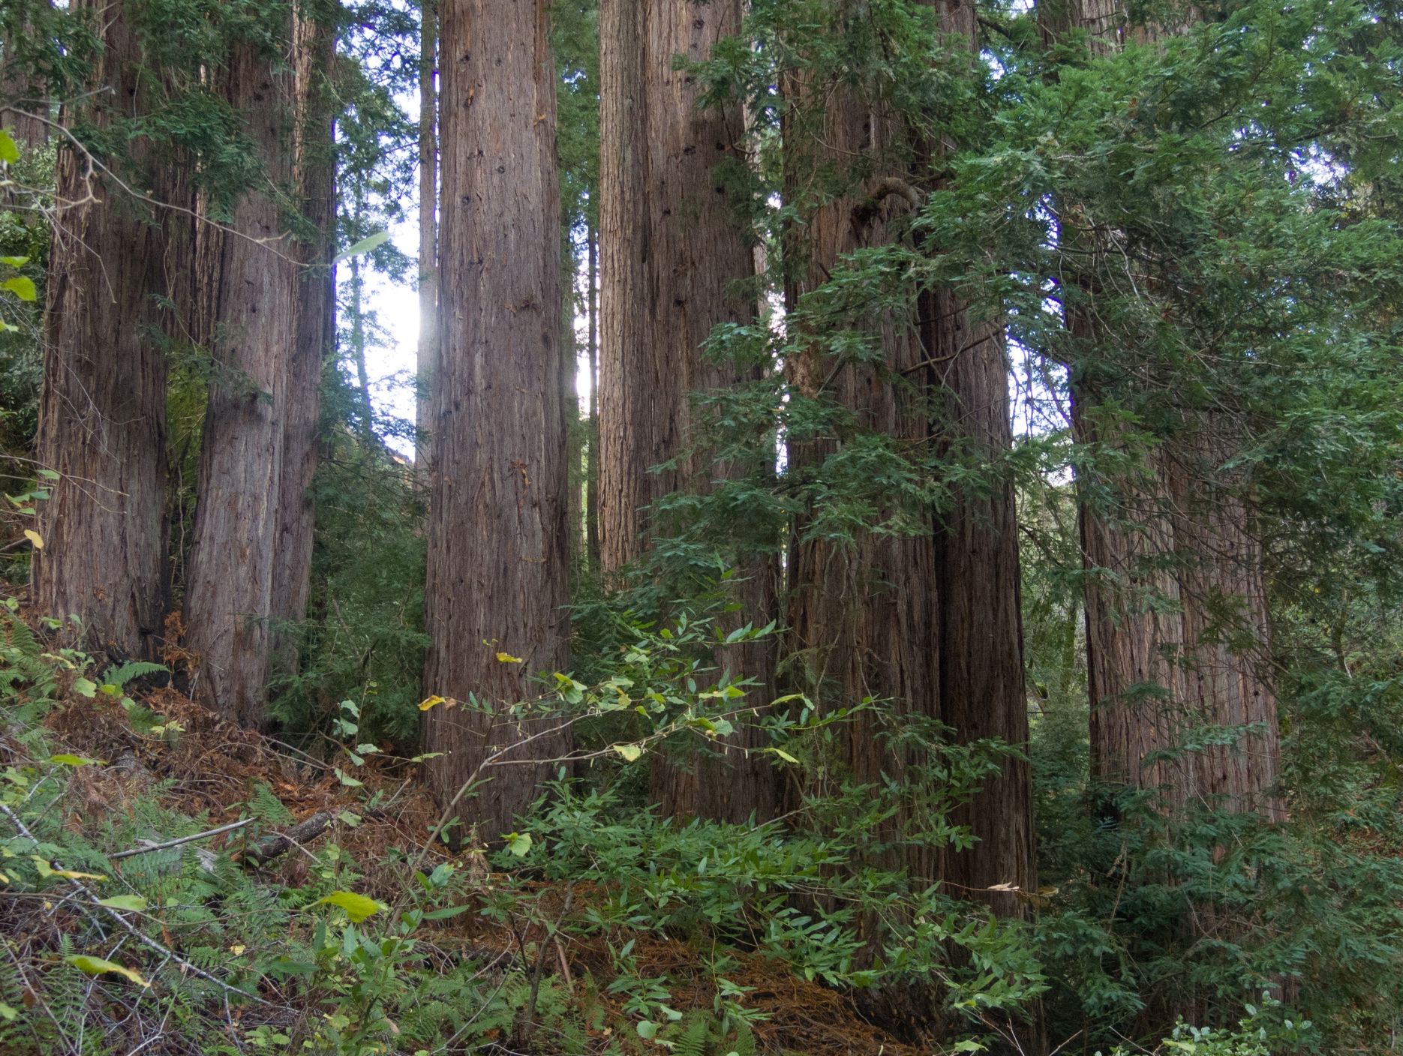
November 2017
Notes:
Clump C was 33 stems from four stumps, all about 40-48” I did take some of the junk out of it 20 years ago as preparation for logging but it needs more.
Again, a 48” redwood is likely no more than 110-120 years old. You can see how close together they are; so this really needs to be thinned.
So if the trees from those four original stumps were cut in 1890, that puts those four starting right after the Spanish burn ban of 1793 More seedlings survive with less fire. And as we shall see, that can be a good thing, or a bad thing, eventually.

Slide 54
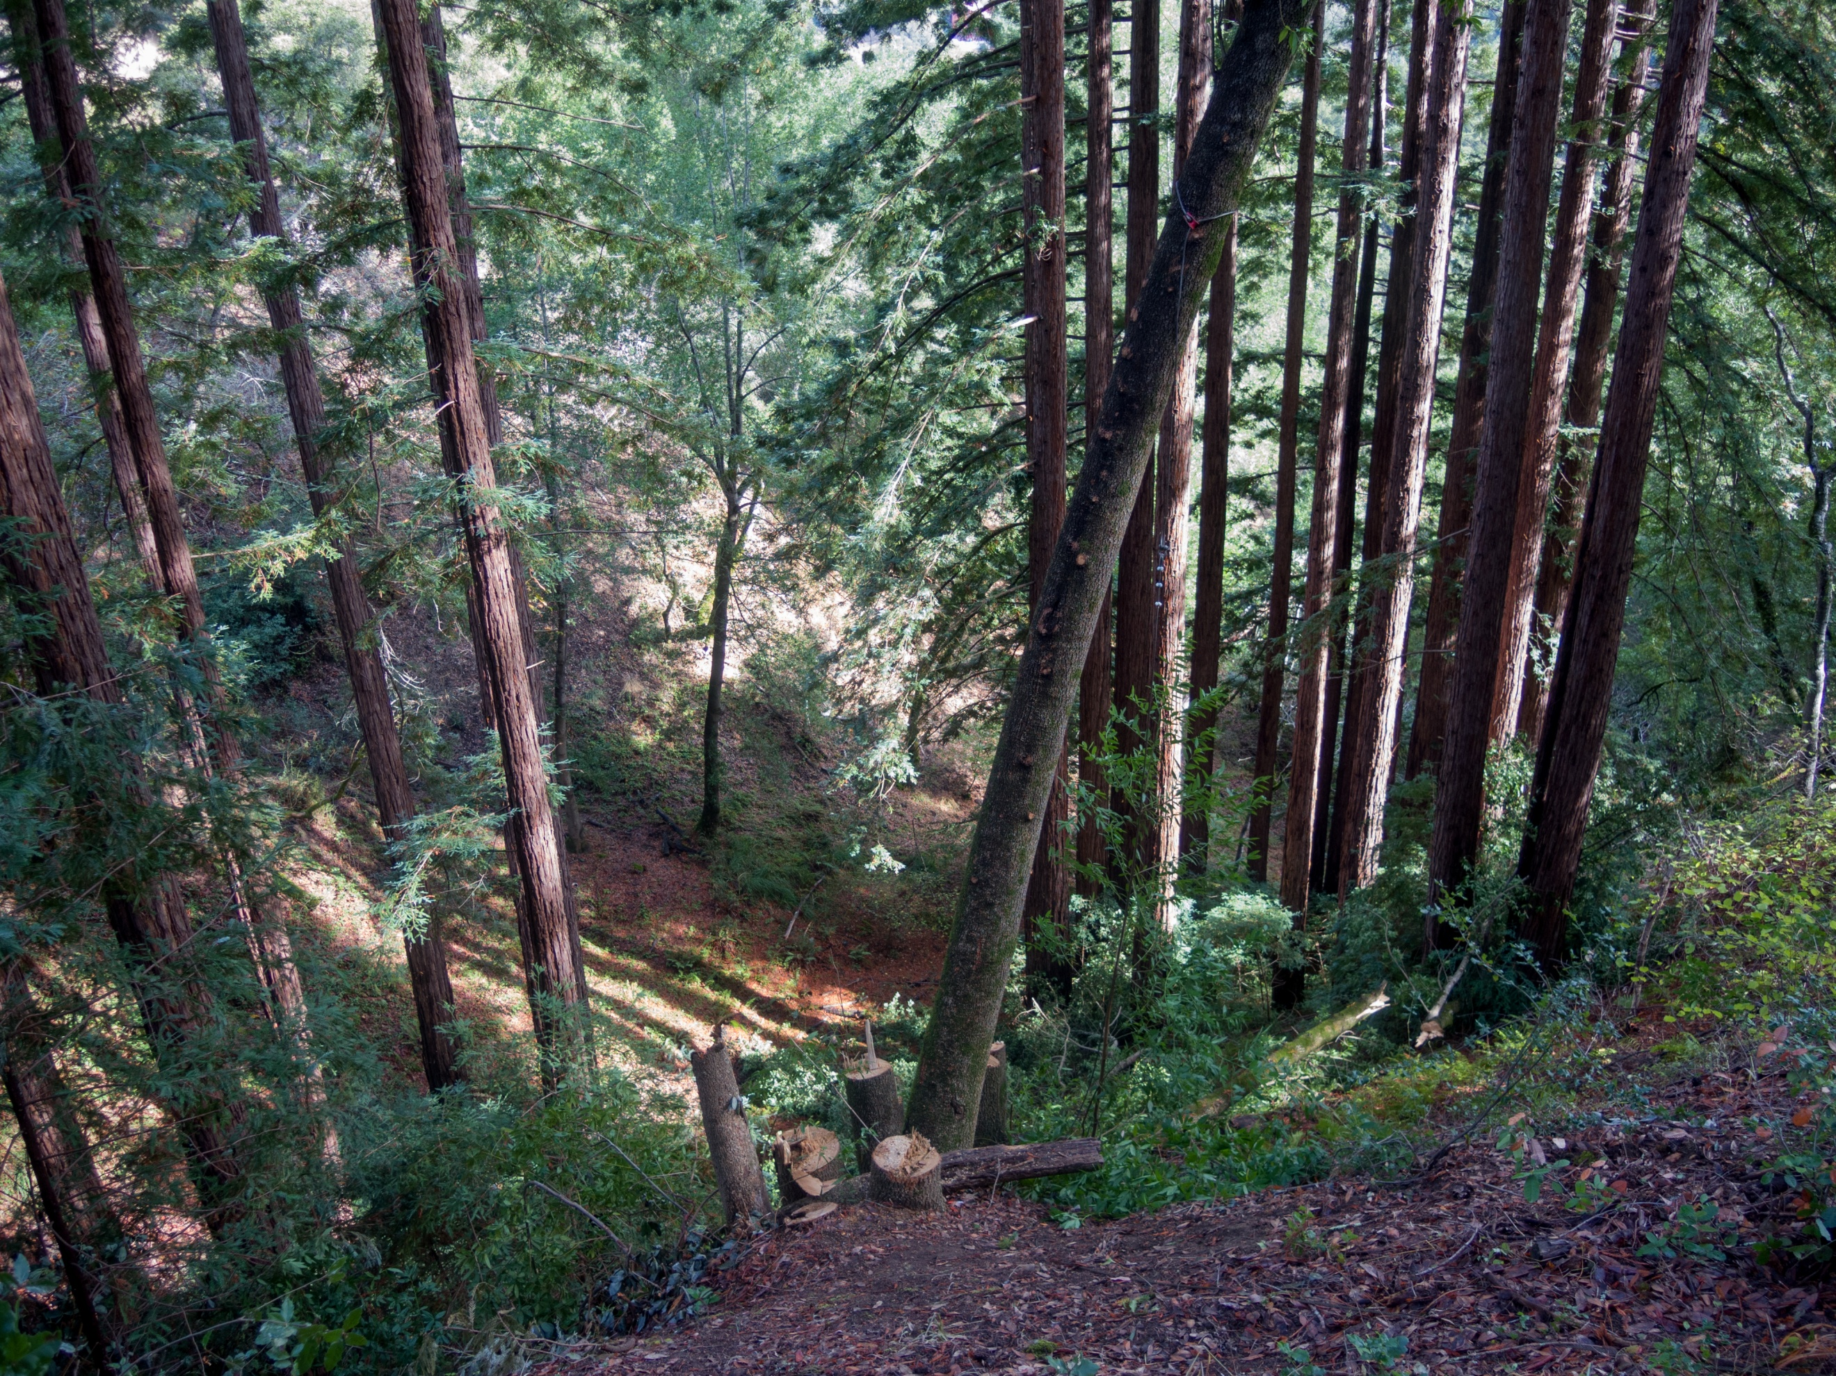
I
C
A
November 2017
Notes:
These are the two lower clumps within the #2 stand. Clump A where Steve and I logged in 2000 and clump C I plan to log soon, but nobody is buying logs and insurance companies don’t like wood siding and decks because people don’t manage fuel enough to reduce the ember storm. The insurers don’t believe anyone really does vegetation management, despite the fact that nobody can build a house that can always survive a catastrophic fire short of a windowless concrete bunker.
I just wish with all my heart I could have been allowed to do what I thought was right. We would all know more and I’d have a better forest and a safer house.
At this time I was removing the bay in the foreground to make a coppice out of it and to make a pathway to get the logs out of Clump C.

Slide 55
I
C
A
November 2017
Notes:
Almost got myself killed climbing that last stem in this photo as it leans out over that scarp from pre-colonial tree #3 and it was rotting inside just above where I cut it. I plan to keep coppicing that bay as a “living retaining wall” to hold the top of that scarp. It is possible that the clump of bay here was started from a tree that fell and started the scarp.
So this is the end of Part I in which I’ve built the background for understanding Part II, which will be both more technical and focused upon the future for old growth.
But we covered this first because we need to learn how to see what we have for how it got that way, in order to have a clue about how to shape its future. We need to popularize that knowledge with which to build experimental bases for redressing what was not done.
We have a lot at stake if we do not.

Slide 56
Copyrights © 2026 by Mark Edward Vande Pol. All rights reserved. No part of this presentation may be transmitted, archived, or reproduced in any manner or form without written permission, except as directed by the fair use doctrine under United States Copyright Law.
All photos and illustrations except as noted are by Mark Edward Vande Pol.
You are permitted to download this presentation without charge for your personal education. You may not edit, or otherwise alter its content in any way. Quoting or excerpting is considered one page and must include reference to the source URL.

